Slide 1
WRAP 2014 Shake-Out Study
Phase III Progress Update
Initial Sensitivity Tests, Revised 2014 GEOS-Chem Modeling and 2014v2 Emission Updates
Ramboll US Corporation and UNC Chapel Hill
RTOWG Webinar
September 10, 2019

Slide 2
WRAP 2014 Shake-Out Study Phase I & II
Phase I and II conducted from Dec 2018 through May 2019
  Developed CAMx & CMAQ 2014v1 36/12-km Shake-Out Study modeling platform
  Transferred the emissions and photochemical modeling files and technology to the IWDW
  Phase I & II of Study documented on IWDW website:
    http://views.cira.colostate.edu/iwdw/docs/waqs_2014v1_shakeout_study.aspx
  Several performance issues were found in the 2014v1 CAMx and CMAQ base case:
    2014v1 BCs based on EPA’s 2014 GEOS-Chem simulation overestimated ozone
    Coastal SO4 was overestimated in CAMx but not CMAQ
    Both CMAQ and in particular CAMx had NO3 underestimation performance issues during high NO3
    BEIS biogenic emissions selected over MEGAN based on limited sensitivity tests (Jan/Jul) but BEIS terpene emissions look high in desert southwest

Slide 3
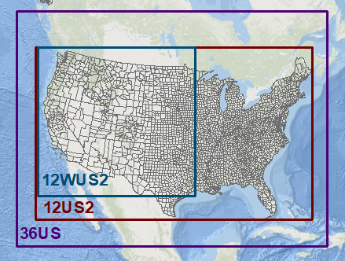
2014v1 Shake-out final configuration
CAMx v6.5 and CMAQ v5.2.1 (April 2018)
WAQS WRF Meteorology using 36-km 36US and 12-km 12WUS2 domains (one-way grid nesting)
  Better precipitation performance than EPA 12-km 12US2
25 vertical layers (collapse from WRF 36 layers)
WRAP Shake-Out 2014v1 emissions
  2014NEIv2 with western state updates for Point & Non-Point
BEIS biogenic emissions
  Sensitivity tests better OA model performance than MEGAN v3.0
  Some MPE issues in final 2014v1 annual runs
Boundary Conditions based on EPA’s 2014 GEOS-Chem simulation with corrected volcano emissions
  EPA GCBCs produced overstated ozone

Slide 4
2014v2 development in Shake-Out Phase III
Revised 2014 GEOS-Chem simulation for better BCs
  Goal: Correct ozone overestimation, improve PM BCs?
2014v2 Emissions Update
  Goal: Correct issues in 2014v1 and replace all of California
Fire Emissions sensitivity Modeling
  Goal: Plume rise sensitivity effects
Final Shake-Out 2014v2 36/12-km CAMx & CMAQ simulations and MPE
  Goal: Final CAMx/CMAQ 2014v2 36/12-km Actual Base Case and MPE
2014 Natural and International Emissions (ZROW) GEOS-Chem & PGM Modeling
  Goal: Estimate modeled natural conditions and contributions of International emissions
2014 Broad Based Source Apportionment
  Goal: Obtain natural, fire, international, etc. source apportionment from which modeled impaired days and other analysis can be performed
Representative Baseline Modeling
  Goal: Modeled conditions for Representative Baseline (2014-2018) Conditions
    Western EGUs (CNEE 2018), O&G (OGWG) and Fires (FSWG)
Dynamic Evaluation Scoping Study
  Goal: Design approach for modeling 2002 using 2014v2 platform to evaluate modeled vs. observed changes in visibility over time
Planned but not yet awarded
  FY Mobile-Source Projections
  2028 modeling using 2014 platform
  Evaluate EPA 2016 Beta-Prime modeling results

Slide 5
Current Phase III 2014 Shake-Out Tasks (Sep 10, 2019)
Task | Description
1.1 | 2014v1 Additional PGM Sensitivity Tests
1.2 | Revised 2014 GEOS-Chem Modeling
1.3 | 2014v2 Emissions Modeling Updates
1.4 | Fire Plume Rise Sensitivity Modeling
1.5 | Additional PGM Sensitivity Tests
1.6 | Annual CMAQ/CAMx 2014v2 Shake-Out and MPE
1.7 | 2014 GEOS-Chem/PGM NAT and ZROW
1.8 | Anthropogenic/Natural PM Source Apportionment
2.1 | Representative Baseline EGU Profiles
2.2 | Rep. Baseline SMOKE fire, O&G and EGUs
2.3 | Rep. Baseline PGM Modeling
3.1 | Dynamic Model Evaluation Scoping Study
5.1 | Management for Phase III Shake-Out Study
Today’s Update
Completed Partially Completed

Slide 6
Task 1.1: Preliminary 2014v1 PGM Sensitivity Tests
Objective: Investigate model performance and other issues that can be performed using the 2014v1 platform before the revised 2014 GEOS-Chem and 2014v2 emissions are available.
  Coastal SO4 overestimation issue in CAMx.
  Switch to CAMx v7.0.
  Investigate bi-direction ammonia deposition scheme in CAMx.
  Re-visit MEGAN vs. BEIS biogenic sensitivity tests.
    Not done yet, MEGAN v3.1 not yet available
  Switch to CMAQ v5.3
    Not done yet, CMAQ v5.3 just released (Aug 27, 2019)
  PPT on Preliminary Sensitivity Simulations.

Slide 7
Task 1.1: Initial Sensitivity Tests using 2014v1
Investigate Coastal SO4 overestimation issue in CAMx
2014v1 Shake-Out final CAMx and CMAQ Model Performance Evaluation found that CAMx overestimated SO4 at coastal sites but CMAQ did not
PORE 24-Hour Bext_{AmmSO4} Performance
Point Reyes, CA (PORE)
Seasonal Extinction Performance
← CAMx summer SO4 overestimation

Slide 8
CAMx Coastal SO4 Performance Issues
Potential causes of CAMx coastal SO4 performance issues
  DMS emissions included in CAMx but not CMAQ
    CAMx v6.5 used in 2014v1 does not include DMS chemistry so DMS re-named as SO2
    DMS emissions uncertain and fairly new processor
    CAM v7.0 has explicit DMS chemistry (DMS → SO2 → SO4)
  Sea Salt processor includes PSO4 emissions (different than in-line CMAQ processor)
  EPA’s 2014 GEOS-Chem run used for BCs (same BCs as used in CMAQ)
    GEOS-Chem DMS species renamed to SO2
    Had issues with GEOS-Chem SO4 BCs causing overestimation in past (2008 & 2011)
Investigate issue with series of CAMx July 2014 sensitivity tests:
  No Sea Salt (SSA) processor PSO4 emissions
  No DMS emissions
  Explicit DMS chemistry (need to migrate from CAMx v6.5 to v7.0)

Slide 9
NO Sea Salt (SSA) PSO4 and DMS Emissions (CAMx v6.5)
No SSA PSO4: Primary SO4 from Sea Salt processor has little effect on SO4 concentrations at PORE
  Observed
  Base Case
  No SSA PSO4
No DMS: Elimination of all DMS emissions as SO2 reduces coastal SO4 overestimation substantially
  Observed
  Base Case
  No DMS Emissions

Slide 10
No DMS emissions as So2 (CAMx v6.5 and v7.0)
CAMx v7.0 behaves the same as v6.5 in response to removing DMS emissions treated as SO2
  Observed
  CAMx v6.5 Base Case
  CAMx v7.0 Base Case
  CAMx v6.5 no DMS Emissions
  CAMx v7.0 no DMS Emissions
Even with no DMS emissions, July SO4 overestimation at Coastal sites

Slide 11
Explicit treatment of dms chemistry plus no dms emissions (CAMx v7.0)
Explicit DMS chemistry treatment results in small reductions in coastal SO4 concentrations but still overestimated
  Observed
  CAMx v7.0 Base Case
  CAMx v7.0 Explicit DMS Chemistry with DMS Emissions
  CAMx v7.0 Explicit DMS Chemistry with DMS Emissions and BC
  CAMx v7.0 no DMS Emissions

Slide 12
Next Steps on Coastal So4 overestimation issue
Explicit treatment of DMS chemistry does not correct coastal SO4 overestimation
  DMS emissions are uncertain and are a fairly new addition to the CAMx Oceanic Processor
Complete elimination of DMS emissions reduced Jul SO4 overestimation by half
  Potentially other sources of SO4 overstatement (GCBCs?)
Can’t really justify not using DMS emissions as it is largest non-volcanic natural source of reactive sulfur (SO2/SO4) emissions
  Track with source apportionment to see how far inland DMS SO4 extends with 2014v2 platform
Move to CAMx v7.0 for future 2014v2 modeling
  Explicit DMS chemistry
  Ability to perform Source Apportionment on BCs
    Will allow separate tracking of Natural vs. Anthropogenic sources from outside of 36-km Domain

Slide 13
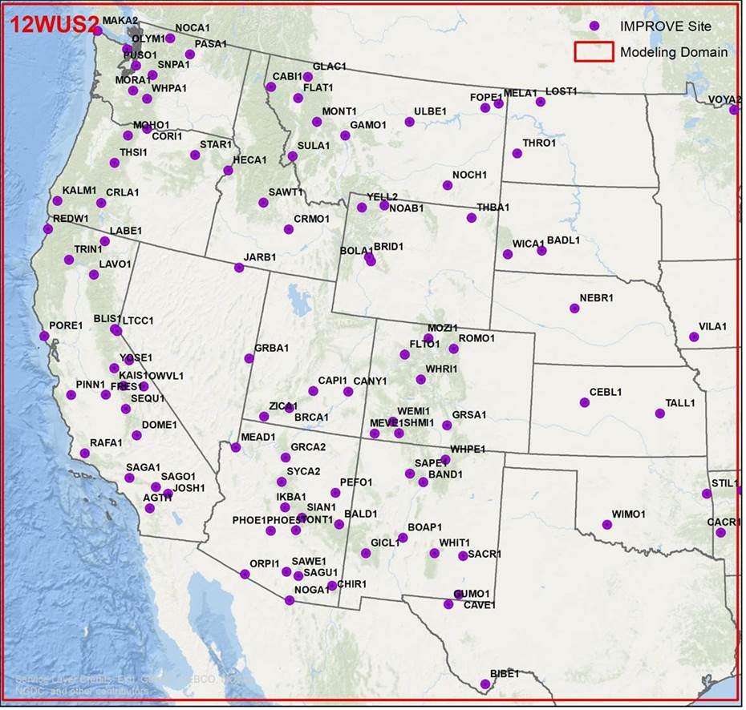
Bi-Directional ammonia Sensitivity Test
CAMx bi-directional ammonia algorithm based on Zhang drydep scheme
  Simple flip switch type option to turn on ammonia bidi in Zhang bidi
Initial test for Jan/Jul using CAMx v7.0 beta
  Compared against CAMx v7.0 base which was 2014v1 database run with CAMX v7.0
    For example, includes DMS as SO2
Bidi added to other updates have added to 2014v1 database
  Includes explicit DMS chemistry BCs
  So changes a couple things at once – other changes don’t affect NO3 so focus on NO3 changes

Slide 14
NH3 BiDi (ORANGE) NO3 – CANY and YELL in Jan/Jul

Slide 15
Conclusions BiDi Ammonia DryDep
As expected, BiDi ammonia drydep increases NH3 and therefore NO3 concentrations
  Mostly small effect
  Relatively more important in summer, but smaller effect in magnitude due to lower NO3
CAMx generally underestimated NO3 extinction in 2014v1
Adopt CAMx v7.0 with bidi drydep for 2014v2 Shake-Out base case modeling

Slide 16
Task 1.2: Revised 2014 GEOS-Chem Simulation
Objective: Conduct 2014 GEOS-Chem using approach used in recent 2016 GEOS-Chem to generate new PGM 36-km GCBCs and perform Jan/Jul PGM sensitivity tests to evaluate new GCBCs that will hopefully reduce ozone overestimation bias.
  2014 GEOS-Chem Simulation
  Process to generate 2014 GCBC
  CAMx BC-only inert (no emissions or chemistry) 2024 annual simulation (with deposition)
  CAMx Jan/Jul GCBC Sensitivity and MPE
  PPT on 2014 GCBC Update

Slide 17
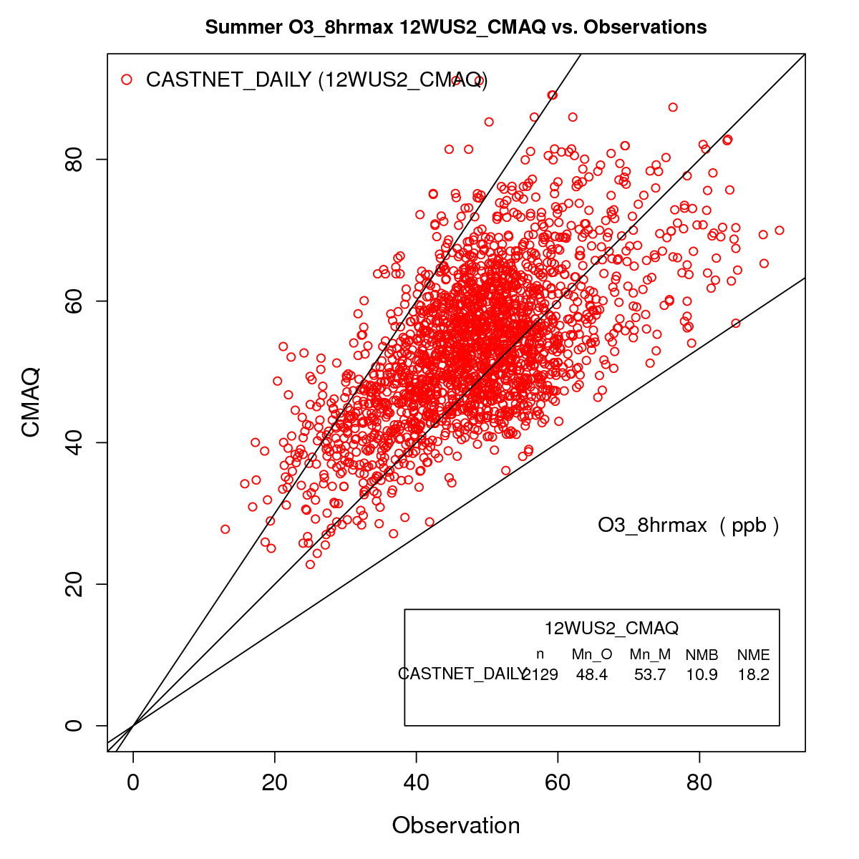
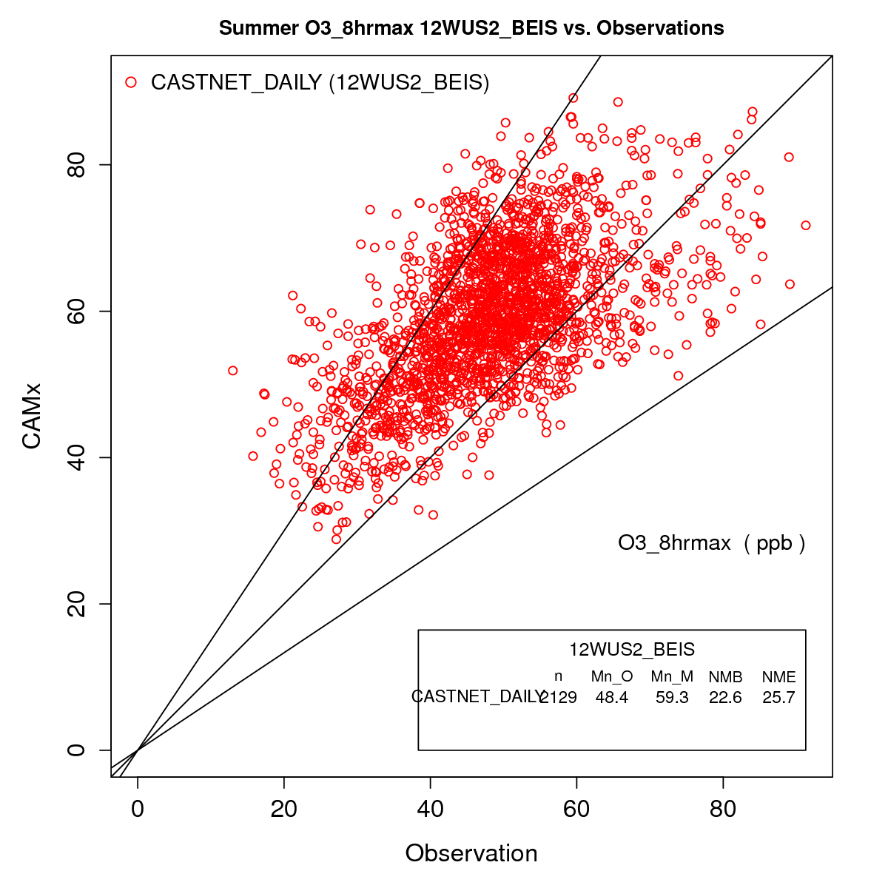
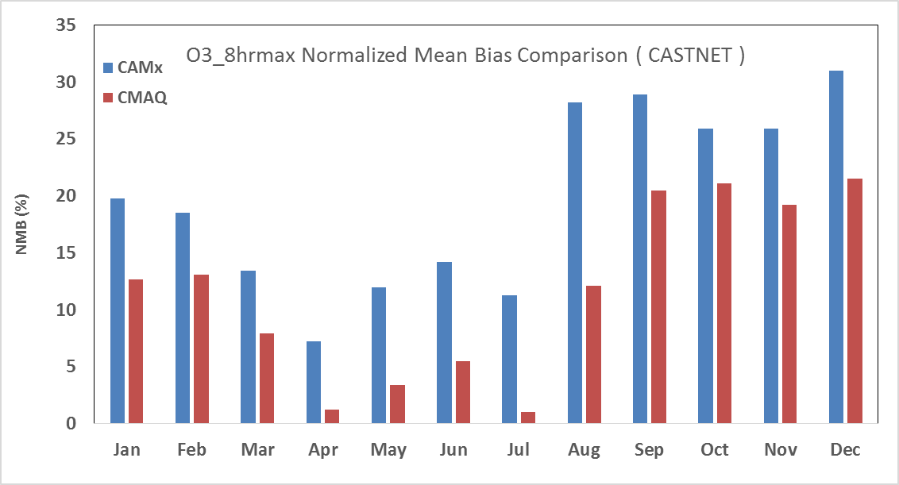
BCs Based on EPA’s 2014 GEOS-Chem had issues
Year-round ozone overestimation bias (especially in colder months)
  In both CMAQ and CAMx, but more pronounced in CAMx
Maybe some SO4 overestimation, even after eliminating volcano eruptions and DMS emissions
Monthly Ozone Bias CAMx/CMAQ
CMAQ
CAMx
17

Slide 18
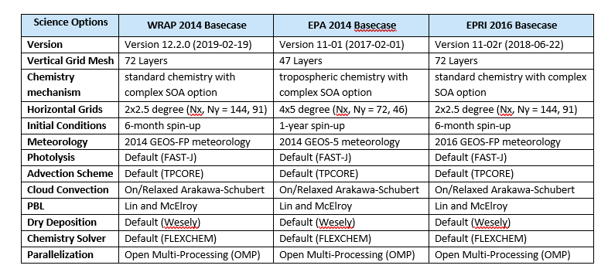
2014 WRAP & EPA and 2016 EPRI geos-chem
Many Emission Inventory Updates (e.g., China)

Slide 19
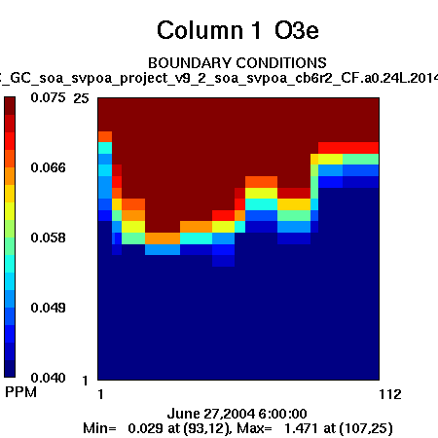
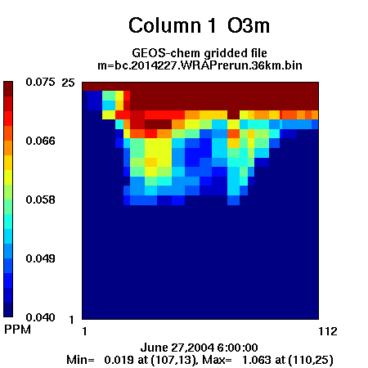
Western 36us3 ozone BC boundary conditions (ppm)
EPA 2014 GEOS-Chem
Revised 2014 GEOS-Chem
19

Slide 20
BC-Only Inert
May-Aug
CAMx run with just GCBCs (EPA vs. WRAP) with deposition but no chemistry (inert)
Without emissions and chemistry expect CAMx to underestimate ozone
EPA GCBC w/ and w/o cap overestimates ozone at Gothic CO (GTH) and Canyonlands UT (CAN)
WRAP GCBC underestimates observed ozone at GTH and CAN

Slide 21
CAMx BC-Only Inert MDA8 ozone LAV, GTH & CAN
EPA GCBC →
← WRAP GCBC
21

Slide 22
CAMx BC-Only EPA GCBC and WRAP GCBC – SO4
PORE
YOSE
GRBA
MOZI

Slide 23
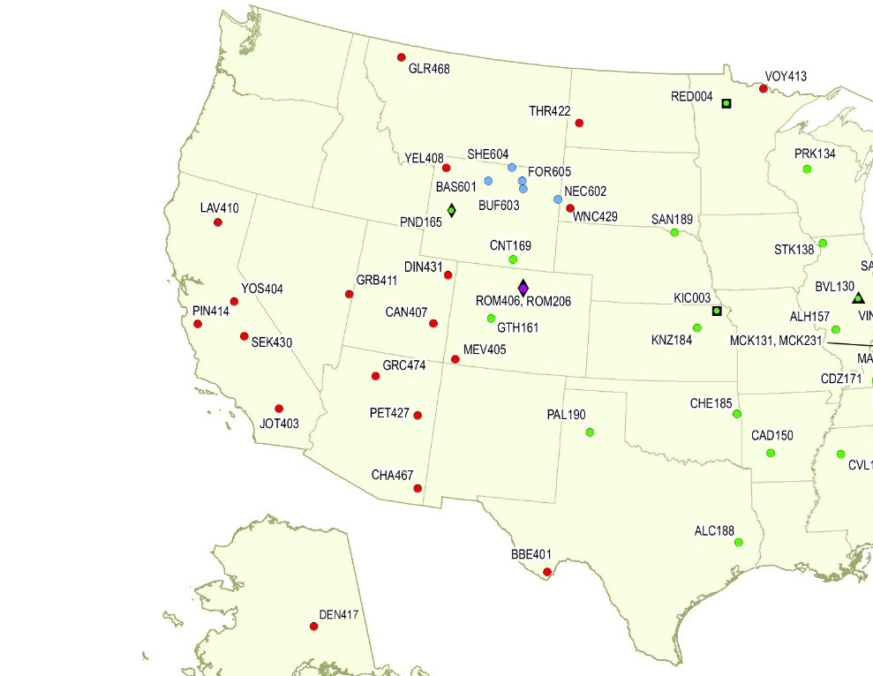
CAMx Photochemical sensitivity tests WRAP 2014 GCBC
Jan/Jul CAMx 2014v1 36-km with new WRAP 2014 GCBC
  2014v1 Emissions
  Full Chemistry
New CAMx Base Case Configuration
  CAMx v7.0 Beta
  Explicit DMS Chemistry
  NH3 bidi drydep
Compare against using EPA 2014 GCBC
Evaluate for MDA8 ozone at CASTNet sites
Evaluate for PM at IMPROVE sites

Slide 24
Lav410 – Lava Beds CA & PIN414 – Pinnacles CA
Jan
Jul

Slide 25
YOS404 – Yosemite CA & SEK403 – Sequoia CA
Jan
Jul

Slide 26
GRB411 – Great Basin NV & CAN407 Canyon Lands UT
Jan
Jul

Slide 27
Yel408 – Yellowstone WY & GTH161 – Gothic CO
Jan
Jul

Slide 28
Conclusions EPA vs WRAP 2014 GEOS-Chem BC Ozone
CASTNet Mean Normalized Bias (NMB)
  Bold = Better Performing GCBC
  Yellow Shading = Not Achieving Ozone <±15% Performance Criteria (Emery 2018; EPA, 1991)
Ozone 2014 GCBC Sensitivity Results
Of the 14 CASTNet sites analyzed the Jan/Jul ozone NMB:
  WRAP GCBC performs better than EPA GCBC 79% of the time
    71% in Jan & 86% in Jul
EPA GCBC fails to achieves the ±<15% Performance Criteria half (14 or 50%) of the time
  Compare 4 or 14% of time for WRAP GCBC
The WRAP re-run of 2014 GEOS-Chem BCs resulted in much better CAMx ozone model performance than using EPA 2014 GEOS-Chem BCs

Slide 29
SO4 2014 EPA GCBC vs. WRAP GCBC – PORE/GRBA & JAN/JUl
EPA and WRAP 2014 GCBC produce similar SO4 MPE Jan/Jul

Slide 30
SO4 & NO3 2014 EPA GCBC vs. WRAP GCBC – CANY & JAN/Jul
Jan Jul
SO4
NO3
EPA/WRAP 2014 GCBC similar SO4/NO3 MPE Jan/Jul @ CANY

Slide 31
EC & OA 2014 EPA GCBC vs. WRAP GCBC – CANY & JAN/Jul
EC
OA
Basically similar EC/OA MPE Jan/Jul @ CANY

Slide 32
Task 1.3: 2014v2 SMOKE Emissions Modeling
SMOKE California 2014v2 emissions
  California ARB provided all new 2014v2 emissions
SMOKE other Western States 2014v2 emission updates
  Mostly minor Point & Non-Point updates
New 2014v2 O&G emissions for 7 of 8 western states w/ significant O&G
  Replaces 2014NEIv2 O&G used in 2014v1
Merge 2014v2 anthropogenic emissions
Transfer 2014v2 emissions and SMOKE set-up from UNC to Ramboll and IWDW

Slide 33
2014v1 Emissions Data Sources
Anthro Emissions: 2014NEIv2 with Updates from Western States
Biogenic Emissions: MEGAN & BEIS Biogenic
Fire Emissions: 2014 NEI (Bluesky) with Fire and Smoke WG Updates
Other Natural Emissions: LNOx; WBD; SS/DMS CAMx processors
EPA has developed CMAQ-ready emissions based on the 2014 NEI version 2 inventories
Start with the EPA 2014 CMAQ-ready 12-km 12US2 domain emissions and conduct SMOKE processing as needed to update any emission inputs that are different than the 2014 NEIv2
  Example, Oil and Gas, Point and Non-Point source sectors updated by the western states

Slide 34
2014v2 Emissions Updates
WRAP OGWG 2014 inventories for 7 of 8 WRAP O&G states except CA
  CO, MT, NM, ND, SD, UT, WY
California ARB provided new 2014 emissions from all sources
New Pima County, AZ (FIPS: 4019) point emissions
Minor updates to Point sector to fix issues identified in 2014v1
  Dropped Montana NOx and PM_{2.5} emissions due to naming issues [Fixed]
  Dropped North Dakota point non-EGU emissions [Fixed]
Removed all California emissions from 2014v1 inventories and processed those inventories through SMOKE except Onroad (RPD, RPV, RPH, RPP)
  CA onroad is a separate file in the EPA 2014 platform

Slide 35
New 2014 emissions from California ARB
Pregridded Emissions: Aircraft, Onroad, and RWC;
Fertilizer and Livestock NH₃;
Ocean Going Vessels (OGV): port and underway emissions;
Paved and unpaved road dust;
Nonpoint including Nonroad; and
Point including EGU and O&G sources
ARB provided a complete SMOKE platform including inventories and ancillary data files for speciation, temporal and gridding surrogates and cross references.

Slide 36
Comparisons of 2014v2 and 2014v1 emissions California: State-Wide TOTAL Changes
California onroad emissions are similar between the two inventories
2014v2 NH3 emissions are much lower than 2014v1

Slide 37
Comparisons of 2014v2 and 2014v1 emissions
Other WRAP States: State-wide Total Changes
2014v2 WY and NM NOx and VOC emissions are higher due to O&G updates

Slide 38
Anthropogenic Emissions: Fugitive Dust vs RoadDust_Unpaved

Slide 39
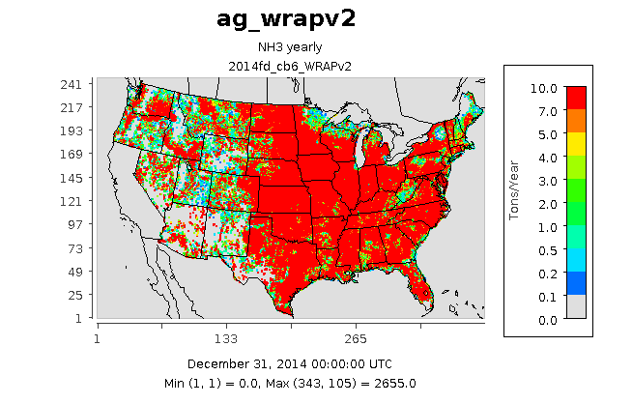
Anthropogenic Emissions: Agricultural and FertNH₃
As expected, high NH3 emissions in California’s Central Valley

Slide 40
Anthropogenic Emissions:
RWC

Slide 41
Anthropogenic Emissions: Nonpoint O&G
2014NEIv2 nonpoint O&G emissions
WRAP OGWG nonpoint O&G emissions

Slide 42
Anthropogenic Emissions: Point Oil & Gas
2014NEIv2 nonpoint O&G emissions
WRAP OGWG nonpoint O&G emissions

Slide 43
California Emissions: Airport, Livestock NH₃, Onroad
ARB provided aircraft emissions within 3000ft ceiling of landing and take-off as 3D NetCDF files

Slide 44
Status of remainder phase III Shake-Out Tasks (1 OF 3)
Task 1.4: Fire Plume Rise Sensitivity – NOT STARTED YET
  Objective: Test WRAP fire plume rise approach in CAMx and compare results against using SMOKE Briggs plume rise.
    Process 2014 fire emissions from AirSci using WRAP plume rise processor.
    CAMx 2014 sensitivity runs for high fire period (e.g., Jul – Sep).
    MPE focusing on fire impact days.
Task 1.5: Additional PGM Sensitivity Tests – MEGAN V3.1 NOT YET AVAILABLE
  Objective: Conduct additional sensitivity tests using updated 2014 GCBCs and 2014v2 emissions.
    New MEGAN v3.1 vs. BEIS emissions.
    ROLL MEGAN V3.1 INTO TASK 1.6
Task 1.6: 2014v2 Annual Shake-Out PGM Modeling -- STARTED
  Objective: Annual CAMx/CMAQ 2014v2 36/12-km Modeling & MPE
    CAMx v7.0 2014v2 36/12-km two-way nest BEIS – ALMOST STARTED
    CAMx v7.0 2014v2 36/12-km two-way nest MEGAN v3.1 – NEED MEGAN V3.1
    CMAQ v5.3 2014v2 36/12-km one-way nest BEIS – SETTING UP CMAQ V5.3
    CMAQ v5.3 2014v2 36/12-km one-way nest MEGAN v3.1 – NEED MEGAN V3.1

Slide 45
Status of remainder phase III Shake-Out Tasks (2 OF 3)
Task 1.7: Natural and ZROW Modeling -- STARTED
  Objective: Conduct linked 2014 GEOS-Chem and PGM 36/12-km modeling for a Natural (no anthropogenic emissions) and ZROW (no international anthro emissions – Zero-Out Rest of World).
    2014 GEOS-Chem Natural Simulation -- DONE
    2014 36/12-km PGM Natural Simulation – WAITING FOR CAMX 2014V2 RUN
    2014 GEOS-Chem ZROW Simulation – STARTED (~4 WEEKS)
    2014 36/12-km PGM ZROW Simulation -- WAITING
Task 1.8: Broad-Based Anthro vs. Natural PM Source Apportionment – NOT STARTED
  Objective: Conduct CAMx 2014v2 36/12-km PSAT Source Apportionment modeling separating contributions of natural and anthropogenic emissions.
    CAMx 2014v2 36/12-km two-way PSAT using 2014 GCBC and 2014 Natural GCBCs and separate tracking of U.S. and non-U.S. anthropogenic emissions.
    Post-processing of and PPT on PSAT results.
Task 2.1: Representative Baseline EGU Emissions and Temporal Profiles -- DONE
  Objective: Develop plan for adding other emissions (i.e., PM, CO, NH3 and VOC) to current Representative Baseline and 2028 future year EGU emissions.
    Draft and Final EGU Representative Baseline plan.

Slide 46
Status of remainder phase III Shake-Out Tasks (3 OF 3)
Task 2.2: Representative Baseline Emissions Modeling – NOT STARTED
  Objective: SMOKE emissions modeling of Representative Baseline EGU, O&G and Fire emissions.
    SMOKE emissions modeling of Representative Baseline and 2028 EGU emissions.
    SMOKE emissions modeling of Representative Baseline O&G emissions.
    SMOKE emissions modeling of Representative Baseline Fire emissions.
    PPT on Representative Baseline emissions modeling.
Task 2.3: Representative Baseline PGM Modeling – NOT STARTED
  Objective: Current representative Baseline CAMx and CMAQ modeling using 2014v2 platform.
    CAMx 36/12-km 2014v2 Representative Baseline modeling.
    CMAQ 36/12-km 2014v2 Representative Baseline modeling.
    PPT on Representative Baseline PGM modeling.
Task 3.1: Dynamic Evaluation Scoping -- STARTED
  Objective: Develop plan for conducting 2002 to 2014 dynamic model evaluation using 2014v2 database.
    Draft plan for conducting dynamic evaluation – WORKING ON DRAFT PLAN
    Final plan for conducting dynamic evaluation.

Slide 47
NEW TASKS NOT YET AWARDED
2028 Mobile Source Emissions Projections
  Objective: To develop 2028 model-ready mobile source emissions for the western U.S.
    On-Road Mobile Sources
    Off-Road Equipment
    Aircraft, Rail and Marine
2028 PGM Modeling and Visibility Projections
  Objective: Conduct 2028 PGM modeling using 2014v2 Platform and make 2028 Visibility Projections
    Assemble 2028 PGM inputs consistent with 2014v2 Representative Baseline
    Conduct 2028 PGM modeling using 2014v2 36/12-km platform
    Make 2028 Visibility Projections Different Ways
Analysis of EPA’s 2016 Beta-Prime Platform and 2028 Visibility Projections
  Objective: Analyze EPA’s 2016 platform and 2028 projections.
    TBD.

Slide 48
Schedule for Modeling – Next two Months
Task | Description | Sep | Oct
1.4 | Fire Plume Rise Sens | WRAP Process CAMx Sens
1.6 | 2014v2 Annual Runs | CAMx BEIS CMAQ BEIS | CAMx MEGAN CMAQ MEGAN
1.7 | Natural and ZROW | CAMx Nat GC ZROW | GC ZROW
1.8 | Broad-Based PM SA |  | CAMx PSAT
2.2 | Rep Base SMOKE | RB EGU, RB O&G, RB Fires | RB Fires
2.3 | Rep Base CAMx |  | RB CAMx
3.1 | Dynamic Eval Scoping | Draft&Final Plan
-- | On-Road Mobile | Start
-- | 2028 CAMx |  | Start in Nov
 | Eval EPA 2016 beta-prime |  | Start

