Slide 1
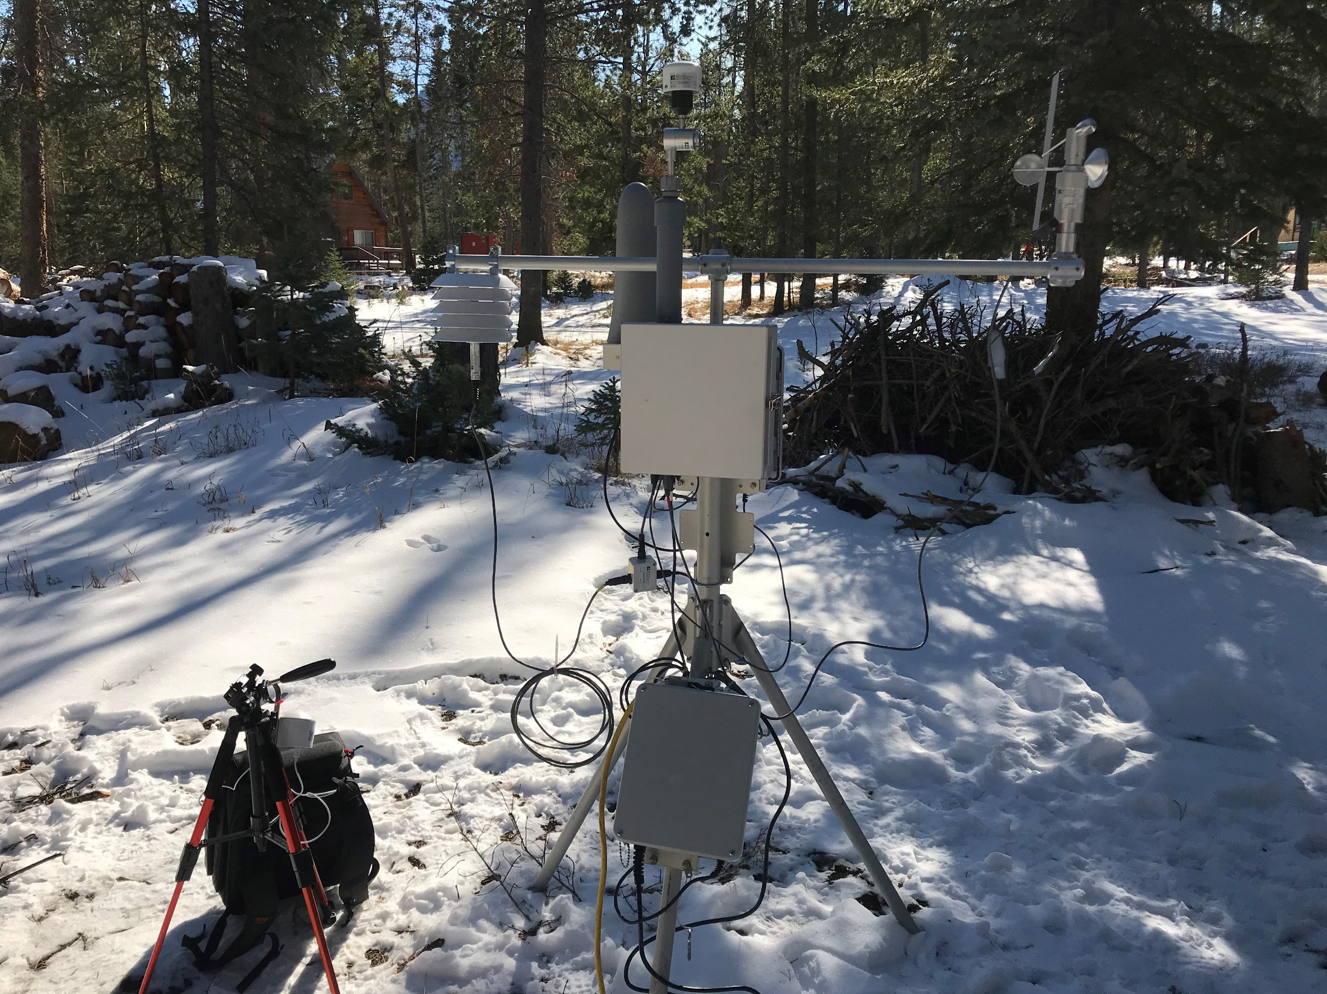
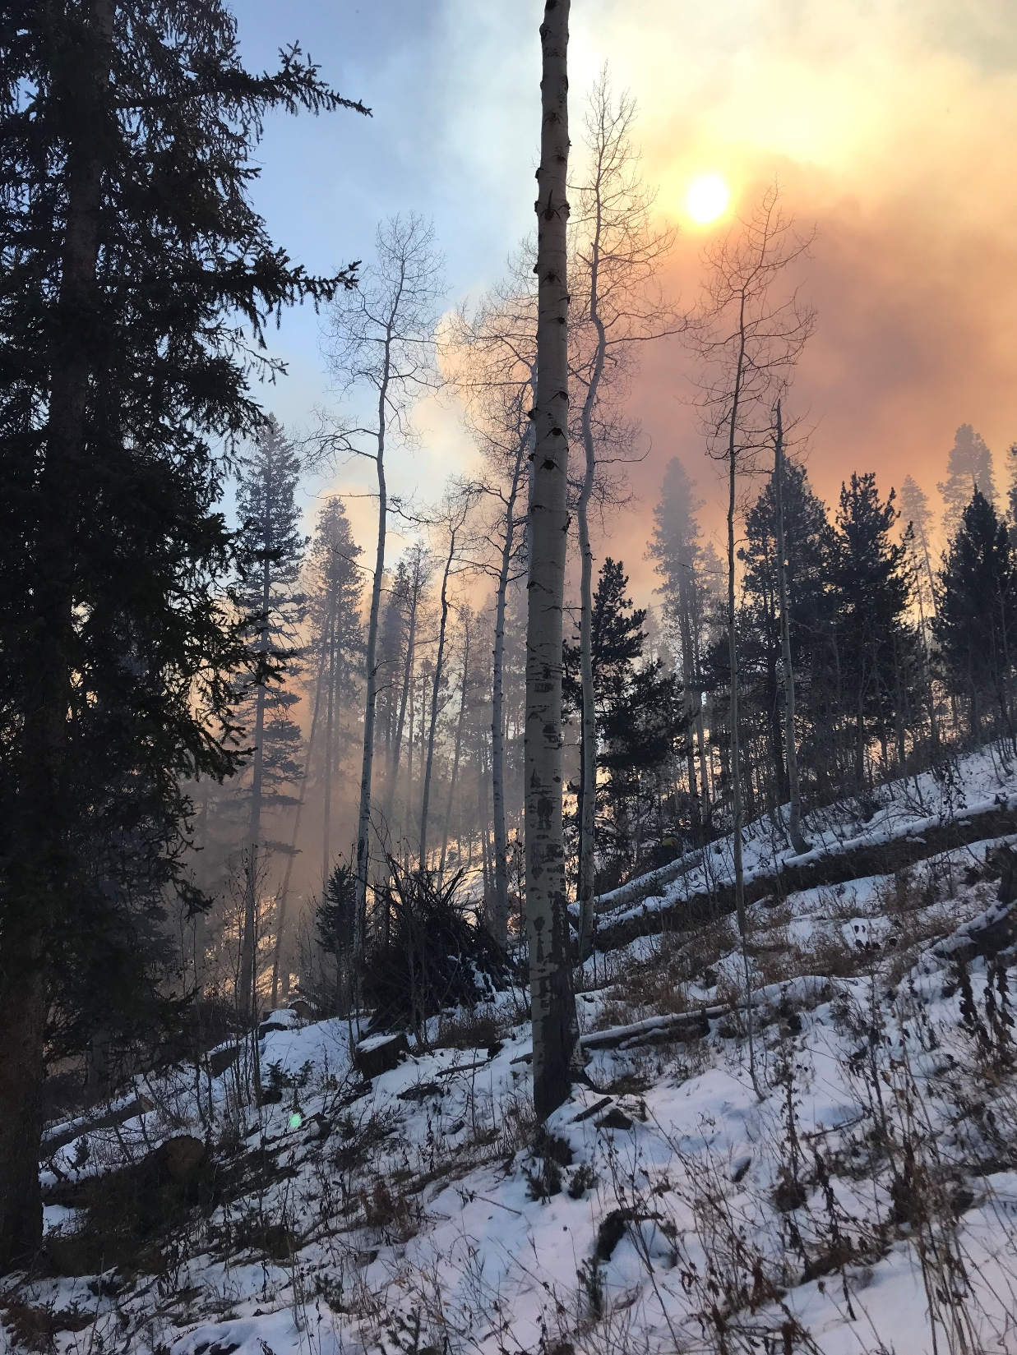
Overview of Rx fire in Utah
Goals
Methods
Findings

Slide 2
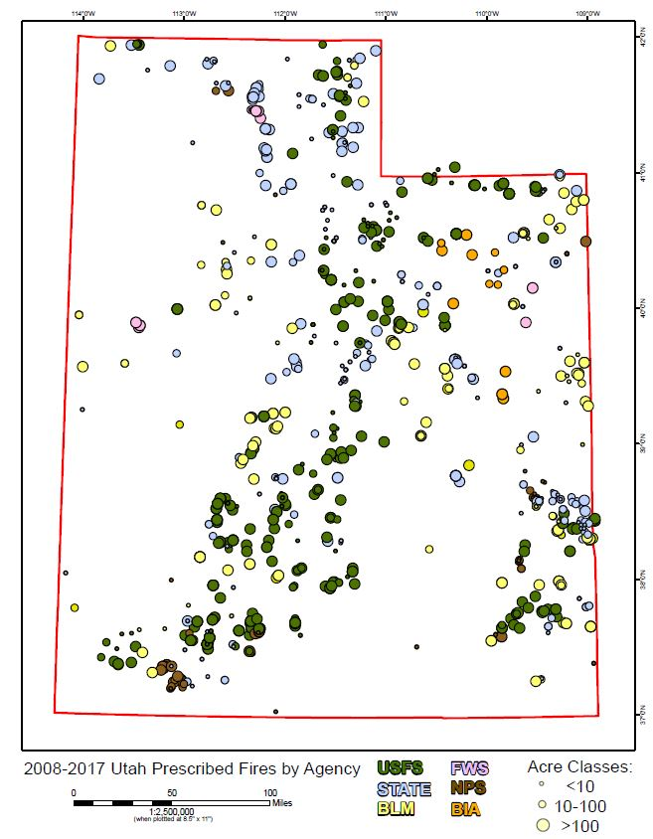
Notes:
The Who, Where, and When. Speak off the cuff as to how much- ~200 burns/year, 20k acres reported for emissions, usually 50k acres reported for target accomplishment, due to mosaic burning, piles, etc.

Slide 3
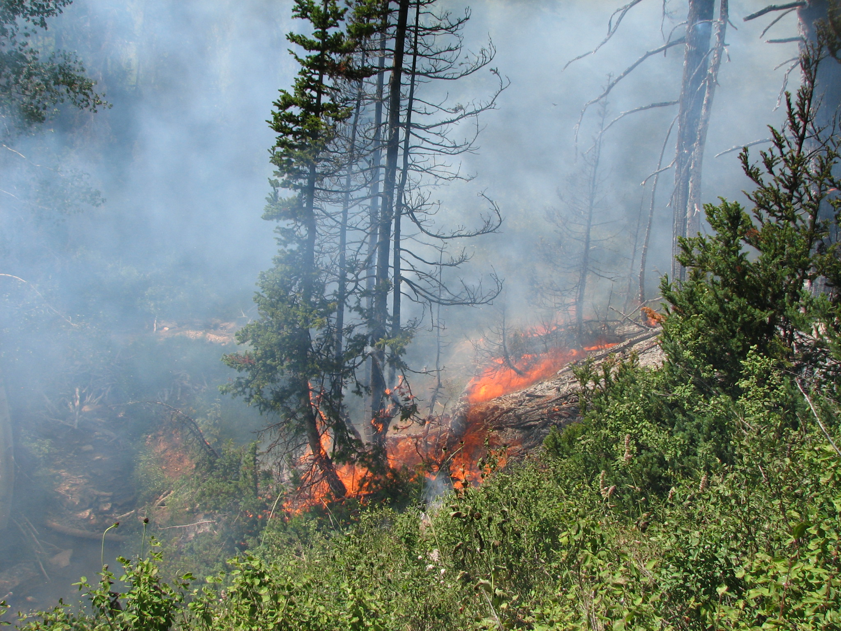
Timber burn for aspen regeneration
Notes:
The What, and Why

Slide 4
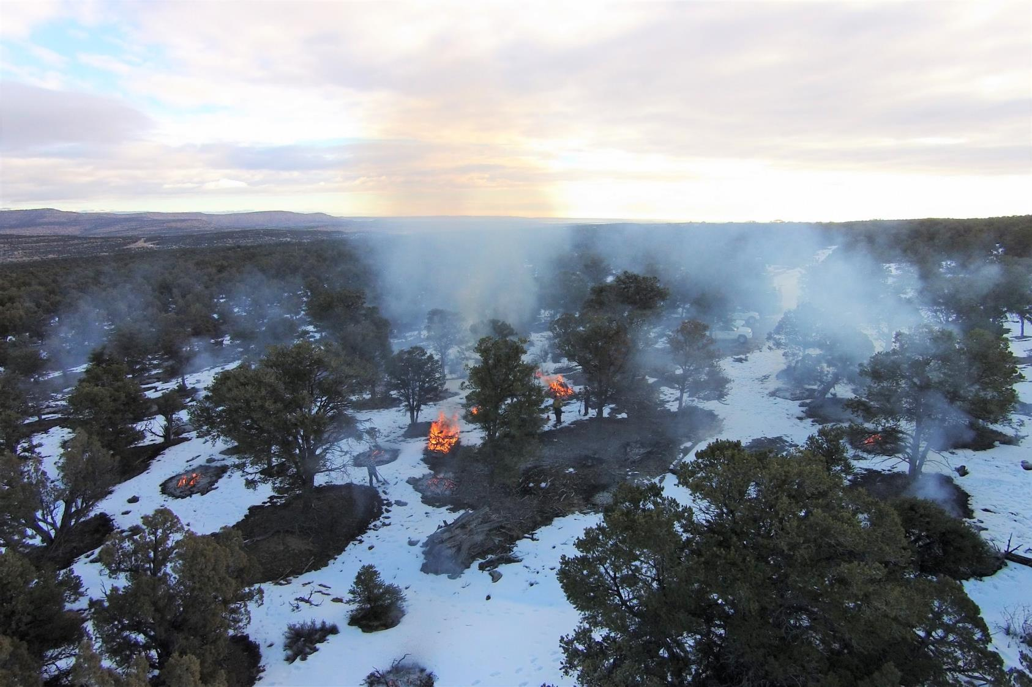
Hand Piles

Slide 5
Biochar

Slide 6
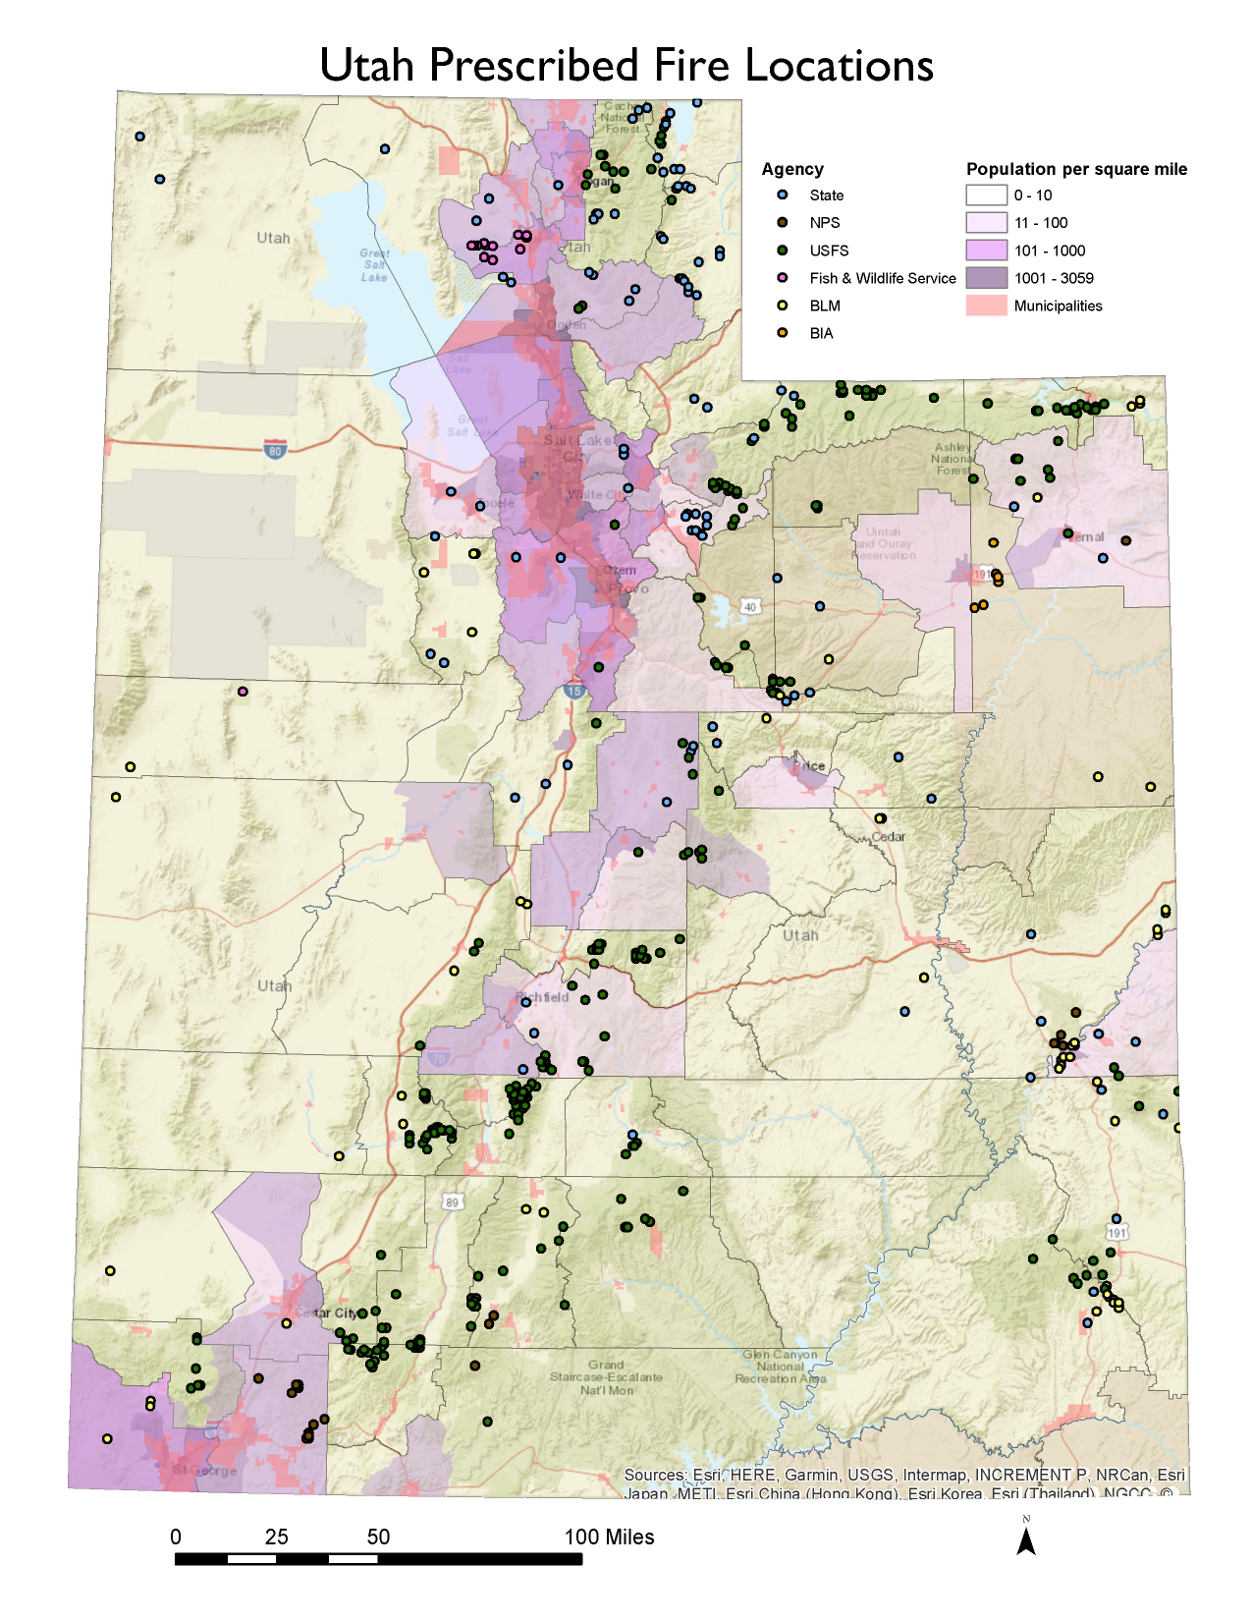
Utah’s SMP and administrative code require a minimum dispersion: clearing index 500+
How to expand the number of allowable burn days?
Use smoke models and ground-truth those forecasts with monitoring equipment.

Slide 7
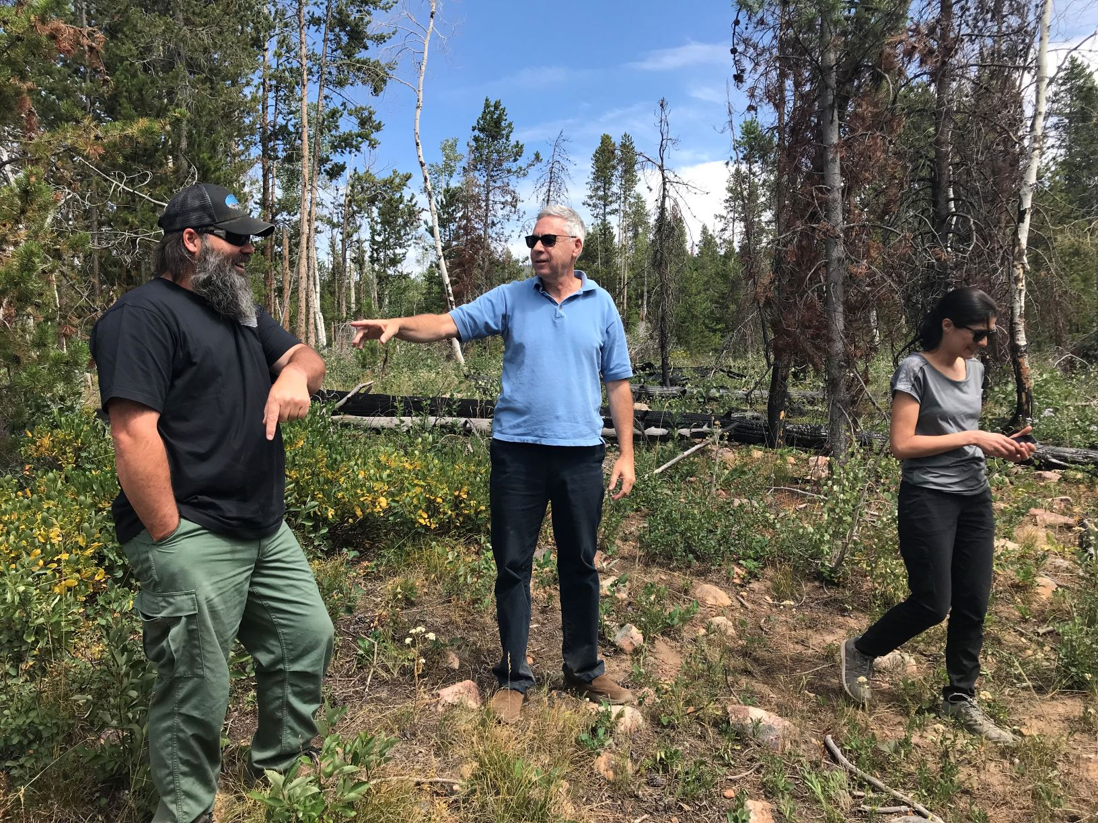
Prescribed fire study
Randy Martin PhD, Utah State University
Nancy Daher PhD, UDAQ
Paul Corrigan, USFS
Joel Karmazyn, UDAQ
Notes:
Joel to chime in on this slide

Slide 8
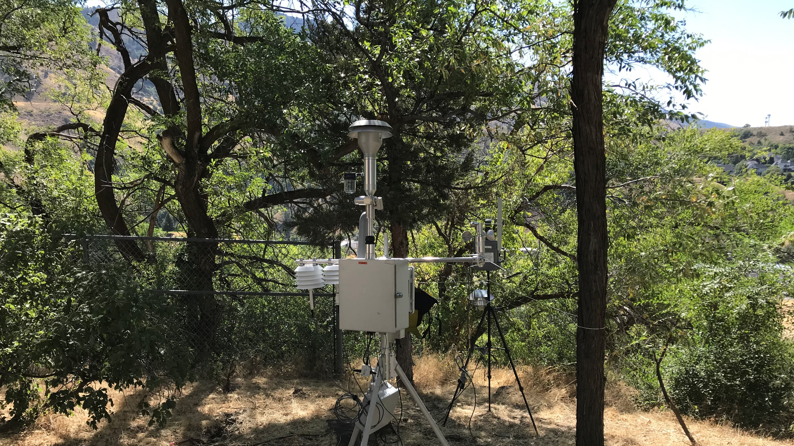
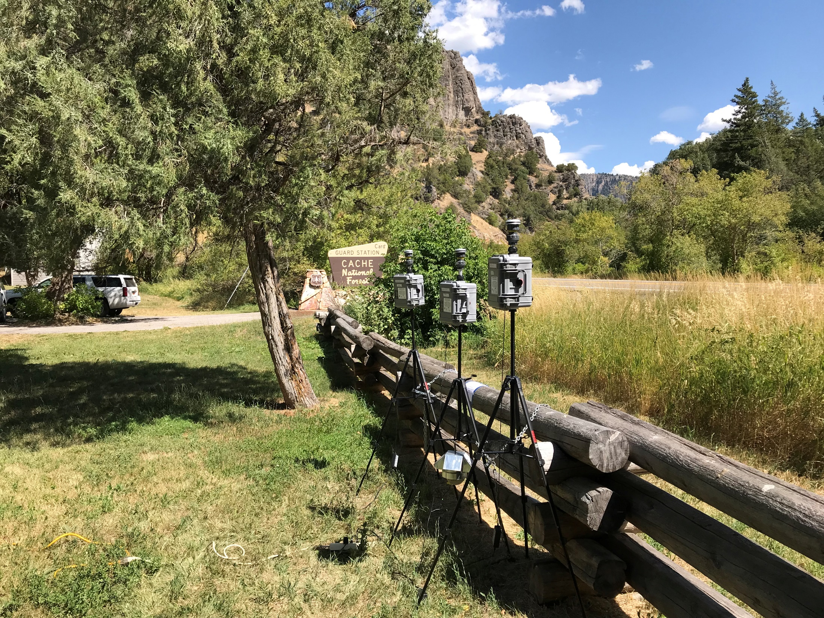
Deploy monitors around Rx fire areas
Set up instruments several days beforehand to understand background
Gather mass/filter-based data (MiniVol) to correct continuous optical instruments (E-sampler, Purple Air, AirU)
Locate instruments upwind, downwind, and at closest receptor

Slide 9
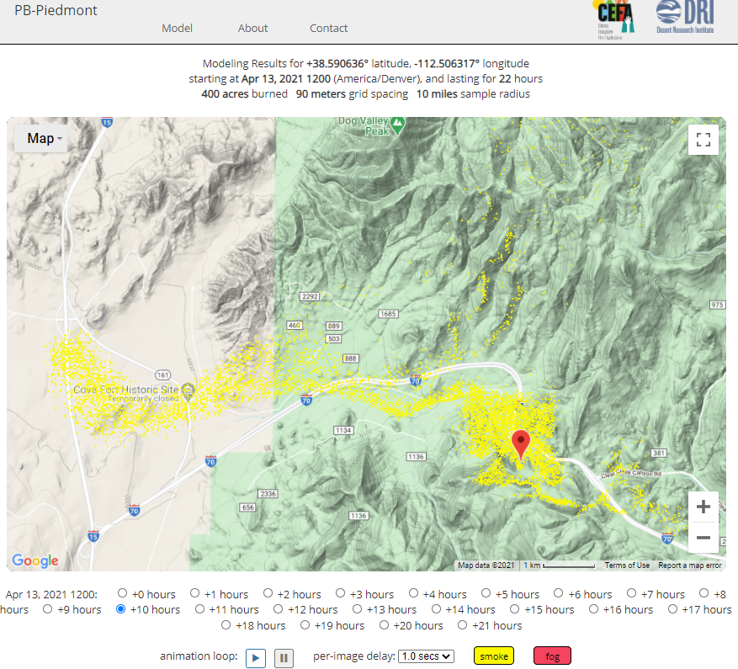
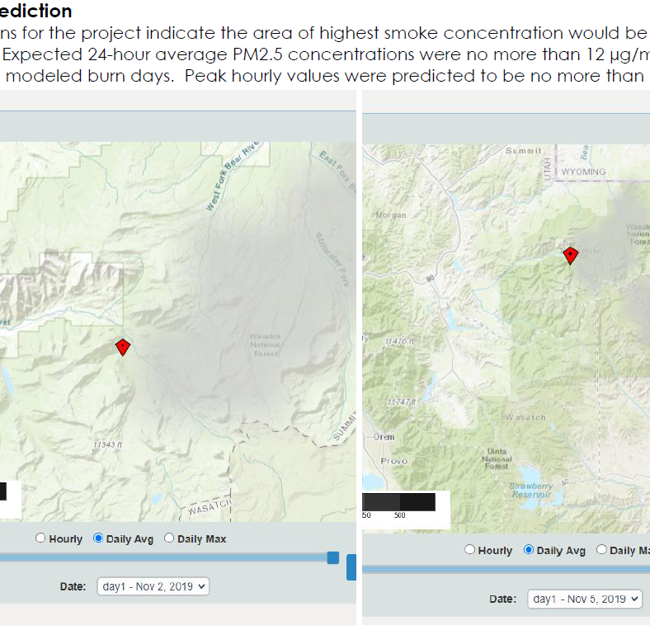
Use models to predict smoke transport and concentration
BlueSky can resolve significant terrain features- e.g. mountain ranges, but is too coarse for really small projects, biochar, small pile burns
PB piedmont is a good option for drainage influenced transport

Slide 11
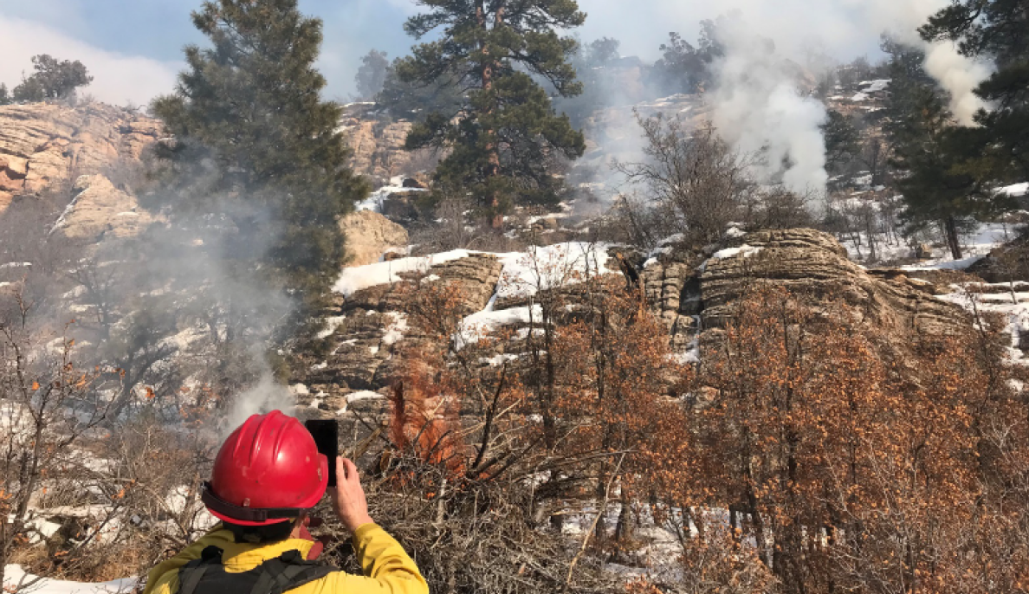
Findings
Distance from burn to monitor had the greatest effect on measured PM2.5
On 41 of 49 days model forecasts were accurate or slightly overpredicted the monitored concentrations
Dispersion (clearing index) was not a great predictor of measured PM concentration, neither was burn size, nor elevation

Slide 12
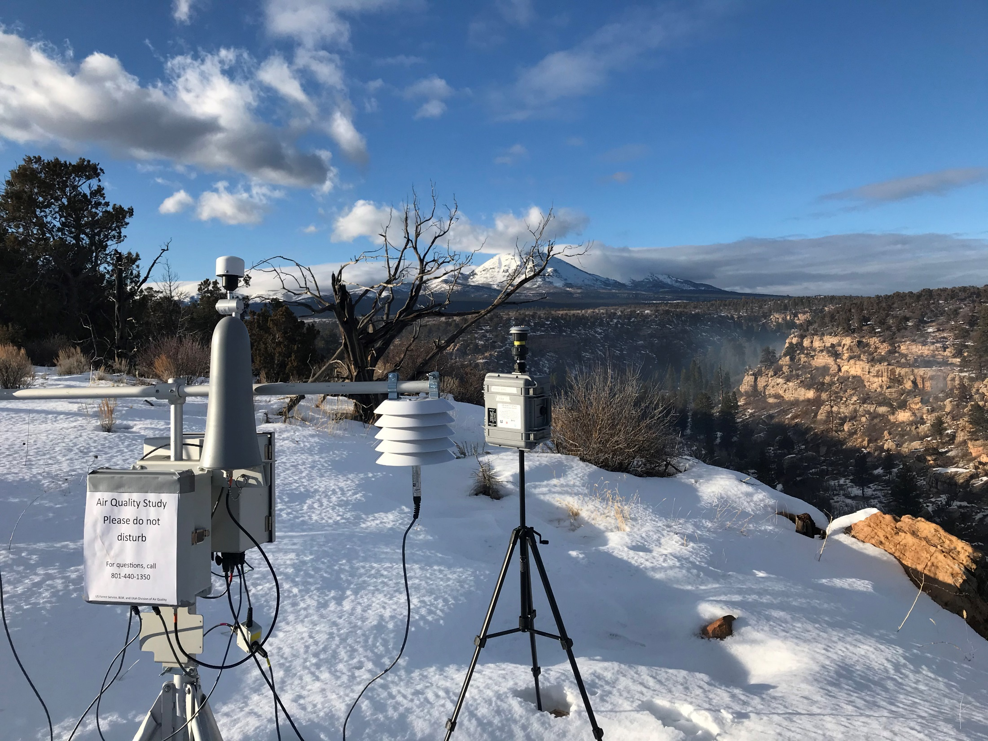
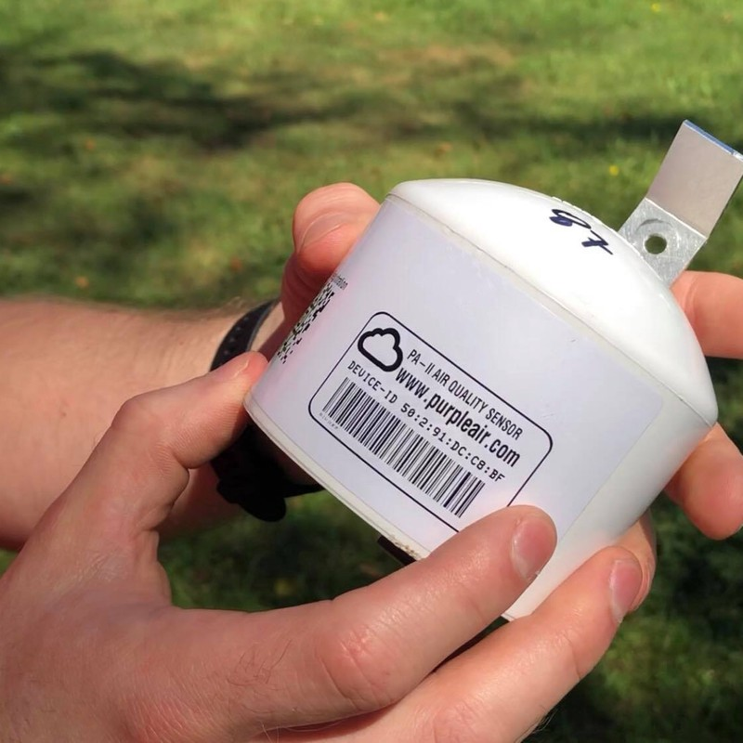
Recommendations
The effects of wind and topography are critical for smoke dispersion
Use multiple forecasting tools when considering smoke in burn permitting (HB92 current process is requiring this of the land manager)
Low cost sensors are the best value
$279
$12,000

