Slide 1
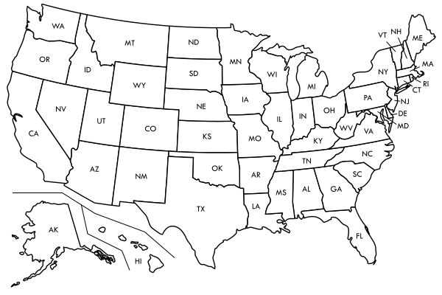
State Screening and Outreach Updates
North Dakota
Colorado
New Mexico

Slide 2
Key Questions to Consider
What is your Q/d threshold? How many sources are “screened in” based on your selected threshold?
How did you determine you had selected enough sources?
Are you focusing on any particular industrial sectors in this round of planning?
Have you contacted the screened sources to discuss the four-factor analysis? How far along are you in these conversations?
How did you (or will you) determine which emitting units at a source require the full four-factor analysis?
Have you consulted informally with EPA, FLMs, or neighboring states/locals/tribes on your screening or analysis? Do you have plans to do so?
Do you have any tips for other states as they work through this process?

Slide 3
State-by-State Status Summary
Jurisdiction | Has notified sources? | Notes on methodology
Alaska | No | Q/d>10, using Q>25 tpy tentatively. Tentatively identified 7 sources, including an airport and AFB
Albuquerque | Have begun discussion with the one reasonable progress source identified for Albuquerque-Bernalillo County. | Albuquerque working in concert with New Mexico for unified statewide analysis.
Arizona | Has held stakeholder meeting. | Q/d>20, excludes airports
California |  | Q/d>10 likely. Will identify more than 100 sources.
Colorado | Sources have been notified by letter. Stakeholder meeting held in June. | Q/d>10, using Q>25 tpy. Currently 22 sources identified.
Hawaii |  | Q/d>10, using Q>25 tpy. 8 sources identified, two airports screened out and sugar mill shutdown.
Idaho | Have not yet contacted facilities. | Q/d>2, using Q>25 tpy. Initial list identified 12 sources.
Montana | Have notified all screened sources by letter and phone call. Met with refineries in May. | Q/d>4, PM10 excluded from Q. Identified 17 sources.
Nevada | Letter to sources is drafted, not yet sent. | Q/d>5 initially identified seven sources, one of which is an airport which will be excluded.
New Mexico | Have not begun notifying non-Albuquerque sources as of date of call, will be notifying them by letter soon. | Q/d>10, resulting in 13 sources for New Mexico outside Albuquerque-Bernalillo County. One source was identified for Albq-BC. Thus, 14 sources statewide. Considering lowering Q/d threshold.
North Dakota | Notified sources by letter in 2018. | Q/d ~ 10. PM10 excluded from Q. Identified 10 sources.
Oregon
South Dakota
Utah | Contacted 4 sources. | Q/d>10 initially. Currently evaluating whether to use a Q/d that is less than 10.
Washington | Drafting letters to local air quality agencies that will go out the week after date of this call; letters to sources will go out the following week. | Q/d>6.5, about 18 sources, excluding airport.
Wyoming | Have not begun notifying sources. | Still finalizing Q/d analysis.

Slide 4
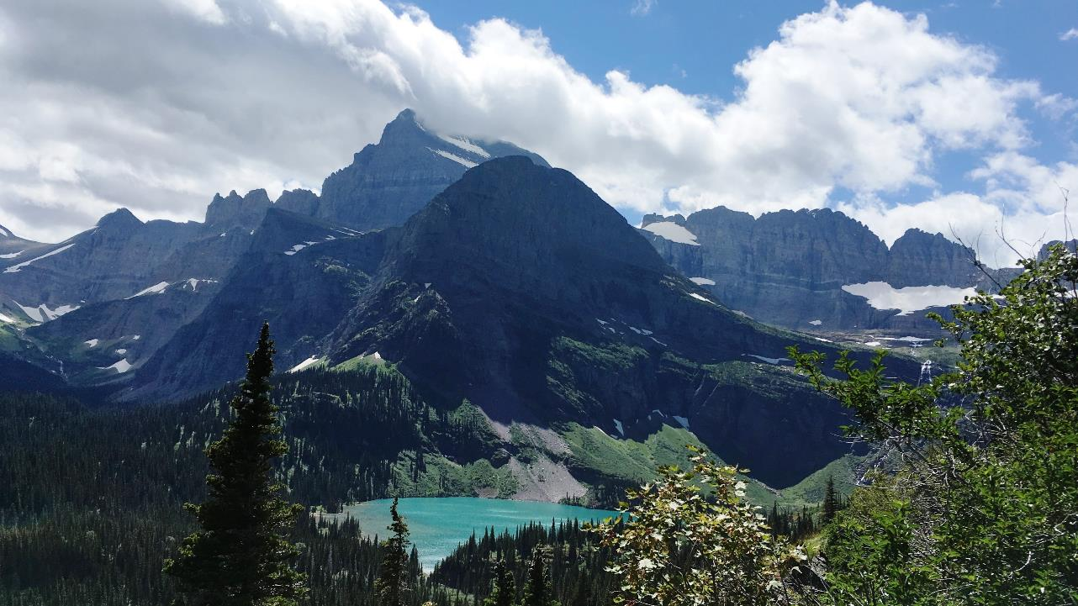
Contact Information
Lisa Devore | Colorado Department of Public Health and Environment | 303.692.3117 | lisa.devore@state.co.us
David Stroh | North Dakota Department of Environmental Quality | 701.328.5188 | destroh@nd.gov
Kerwin Singleton | New Mexico Environment Department | 505.476.4350 | kerwin.singleton@state.nm.us

