Slide 1
Natural Conditions and Trends
Overview of Natural Conditions evaluation work
08/27/2019

Slide 2
Outline (part 1)
Metric Topics
Metric run-through
Alternate Trijonis values (natural conditions)
Future wildfire scenarios
Overview for next steps
Data Topics
Threshold adjustment
Overview for next steps
Part 2: Species-specific data trends

Slide 3
Metric Topics
Metric run-through
Alternate Trijonis values
Future episodic scenarios

Slide 4
Metric run-through
Episodic
Natural
Haze
Routine
Anthropogenic

Slide 5
Natural – Episodic
organic carbon
wildfire
elemental carbon
Episodic
coarse mass
dust
soil

Slide 6
Natural – Episodic
Using 2000-2014 data
(per initial draft guidance, https://www.epa.gov/sites/production/files/2016-07/documents/draft_regional_haze_guidance_july_2016.pdf)
Find the 95%-ile breakpoint for each year:
of the wildfire (elemental + organic carbon)
of the dust (coarse mass + soil)
Determine the minimum of those years (“low wildfire” and “low dust storm” years)
Selects the year with the lowest wildfire contribution, allowing for concentration to be on lower end of elevated episodic concentrations

Slide 7
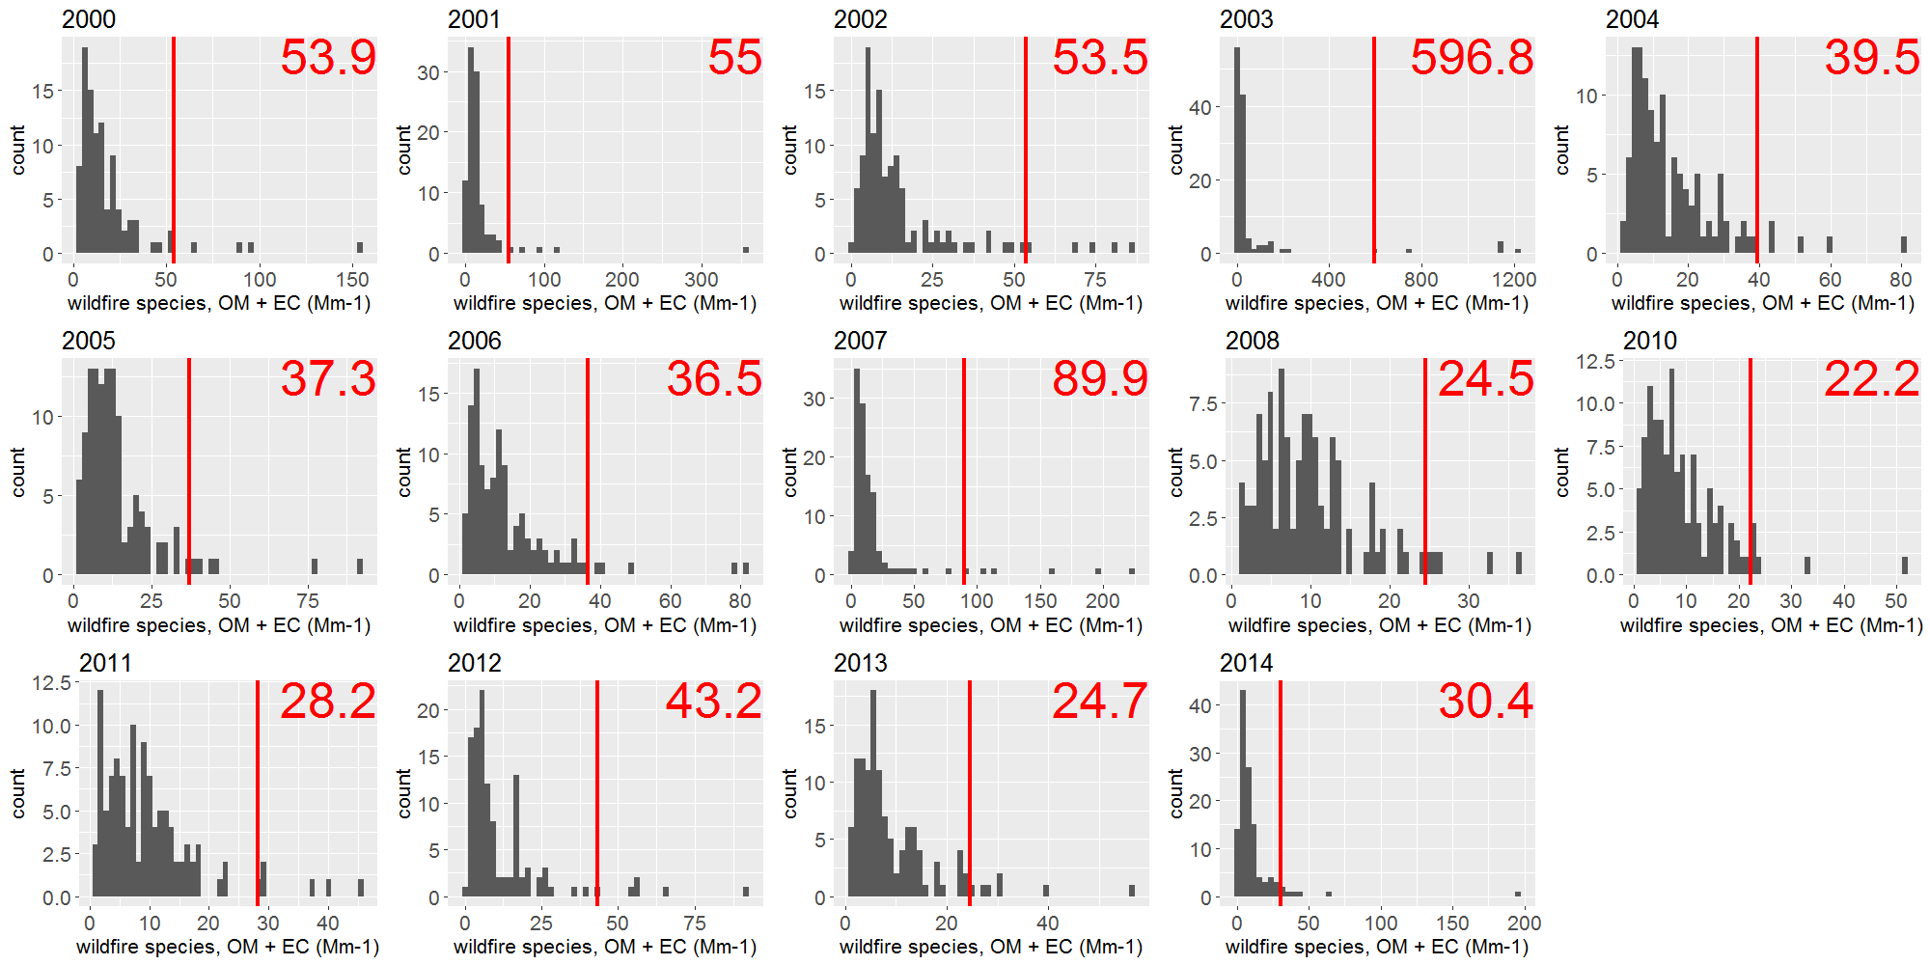
Natural – Episodic (e.g. GLAC1, wildfire)
minimum for episodic wildfire

Slide 8
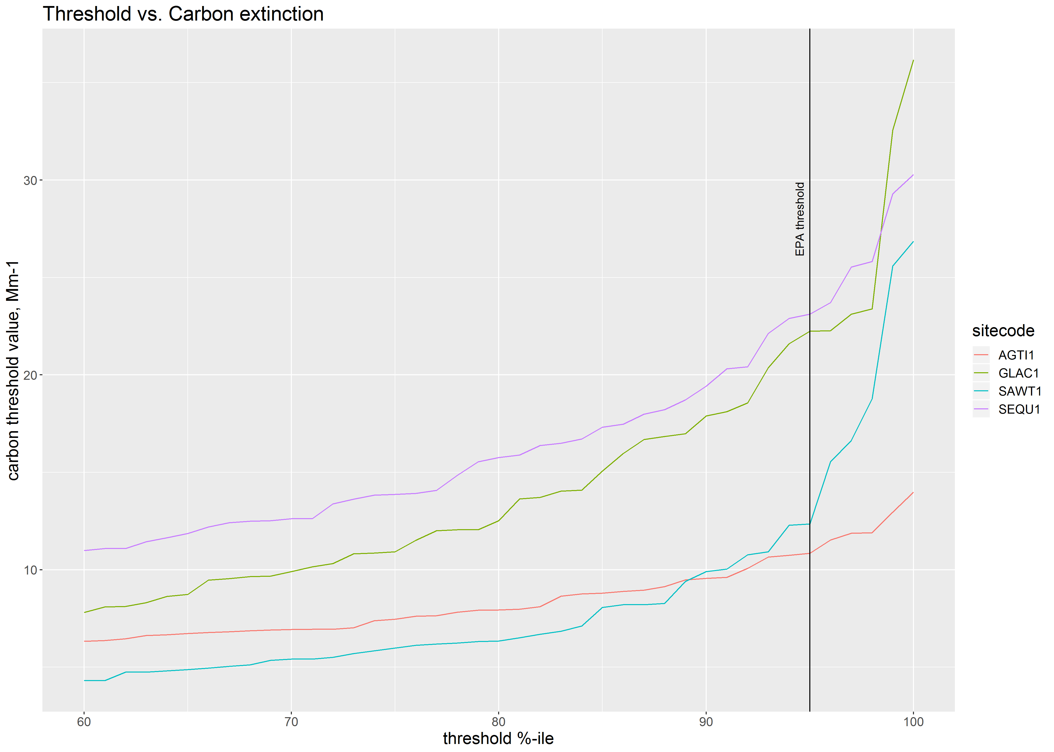
AGTI1: Agua Tibia, urban area southern California
GLAC1: Glacier National Park, remote near northern border
SAWT1: Sawtooth, remote, Idaho mountains
SEQU1: Sequoia, near central valley of California, somewhat urbanized on one side
Carbon threshold vs. site for the given 95%-ile
Carbon threshold vs. threshold, for a given site

Slide 9
Natural – Routine
Trijonis, J. C. Characterization of Natural Background Aerosol Concentrations, Appendix A in Acidic Deposition: State of the Science and Technology, Report 24, Visibility Existing and Historical Condition – Causes and Effects, National Acid Precipitation Assessment Program, 1990.
Trijonis
S. A. Copeland, M. Pitchford, and R. Ames, Regional Haze Rule Natural Level Estimates Using the Revised IMPROVE Aerosol Reconstructed Light Extinction Algorithm, 2008.
http://vista.cira.colostate.edu/improve/Publications/GrayLit/032_NaturalCondIIpaper/Copeland_etal_NaturalConditionsII_Description.pdf
NCII
Natural-routine
Draft Guidance on Progress Tracking Metrics, Long-term Strategies, Reasonable Progress Goals and Other Requirements for Regional Haze State Implementation Plans for the Second Implementation Period, 2016.
https://www.epa.gov/sites/production/files/2016-07/documents/draft_regional_haze_guidance_july_2016.pdf

Slide 10
Natural – Routine
Trijonis values
Estimate of “natural” concentrations for east and west
Based on 1990 report, using visibility data and concentrations measured in the 1970s and 1980s
Values are estimates of “means” (not constants)
For the West, the mass concentrations sum to 4.3 µg/m³
ARS report, 2013 (https://www.wrapair2.org/pdf/WRAP_NaturalConditionsReview_20130625.pdf)
Ammonium Sulfate | 0.115 µg/m³
Ammonium Nitrate | 0.1 µg/m³
Organic Carbon | 0.5994 µg/m³
Elemental Carbon | 0.02 µg/m³
Soil | 0.5 µg/m³
Coarse Mass | 3 µg/m³

Slide 11
Natural – Routine
NCII
Actual concentrations, 2000-2004 data
Re-scale each species so that the yearly averages are equal to the Trijonis value (if the average is already less, it is not re-scaled, scaling factor = 1)
Then, run the re-scaled masses through the new IMPROVE algorithm and find the averages over 2000-2004… those are NCII
Each site and species has it’s own NCII value, in extinction units (Mm-1)
EPA discusses natural-routine and alternative approaches in their TSD to the guidance (https://www.epa.gov/sites/production/files/2016-07/documents/technical_support_document_for_draft_guidance_on_regional_haze.pdf)

Slide 12
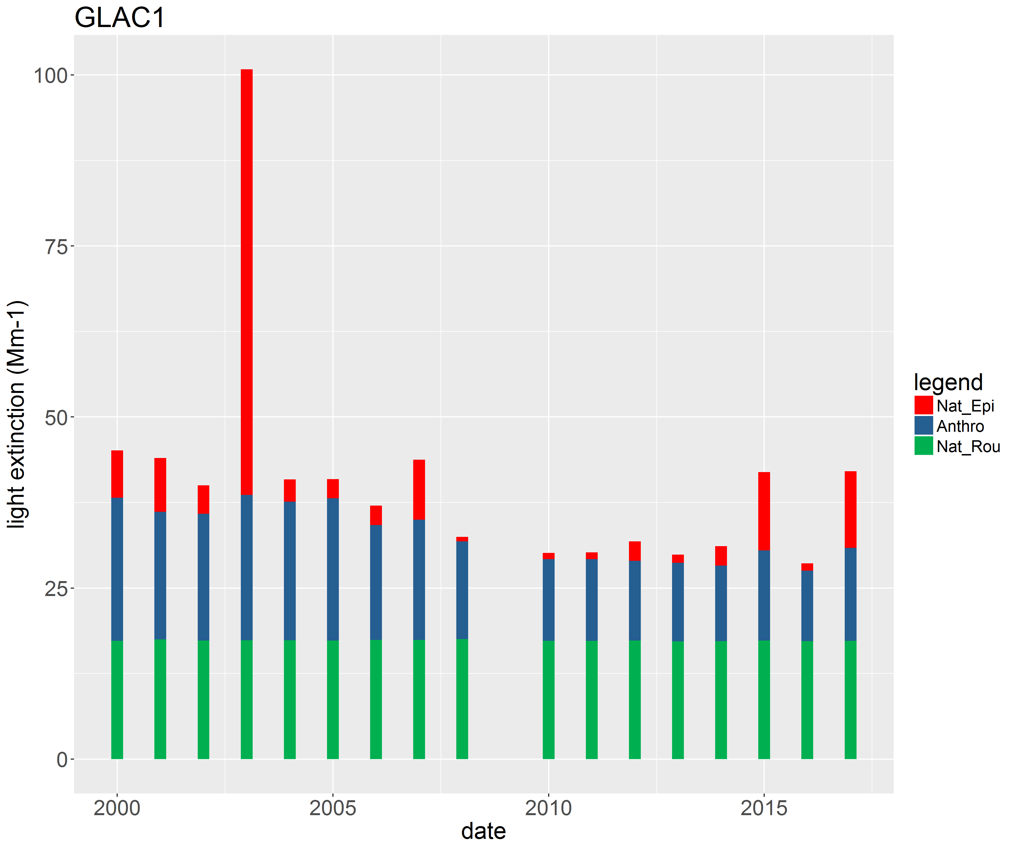
Natural – Routine
$nat.rou=\frac{daily.ext(woE3)}{annual.av(woE3)}×{nc}_{II}$
Annual Average of the natural routine portion = NCII
6 species NCII extinction values +
Sea Salt extinction +
Rayleigh extinction

Slide 13
Natural-routine
Trijonis
NCII
Natural-episodic
Threshold
Anthro-pogenic
Haze

Slide 14
Anthropogenic
Remaining contribution in considered anthropogenic
${ext}_{anthro}={ext}_{total}−{ext}_{natural}$ (in light extinction units, Mm-1)
Days are ranked based on “delta deciview” impairment
${dv}_{anthro}={dv}_{total}−{dv}_{natural}$ (in deciviews)
$dv=10×log⁡(\frac{ext}{10})$
The highest 20% of days, are most impaired days (MIDs)
Since log is a slow growing function, dv_{anthro} becomes more significant when dv_{total} is considerably larger than dv_{natural}
MIDs tend to be days with lower natural contributions:
“Reduction of anthropogenic light extinction on days with high natural light extinction will not be as perceptible as reductions of anthropogenic contributions on days with low natural contributions.”
https://www.epa.gov/sites/production/files/2016-07/documents/draft_regional_haze_guidance_july_2016.pdf

Slide 15
2064 Endpoint
“we averaged the daily natural (the sum of “episodic” and “routine”) light extinction estimates on the 20 percent most impaired days in each year from 2000 to 2014 to determine new estimates of natural visibility conditions.”
Only the natural (no anthropogenic) portions of the most impaired days from 2000-2014 => natural visibility

Slide 16
Metric Topics
Metric run-through
Alternate Trijonis values
Future episodic scenarios

Slide 17
Alternate Trijonis values (natural conditions)
Tried a “clearest days as natural” assumption
Used the mean of each species on the clearest days (2000-2017) to suggest alternate Trijonis inputs
(also considered the lowest 20%-ile of each species as “natural”)
Calculate the NCII numbers as is currently done
This establishes new “natural-routine” portions, and also affects the endpoint

Slide 18
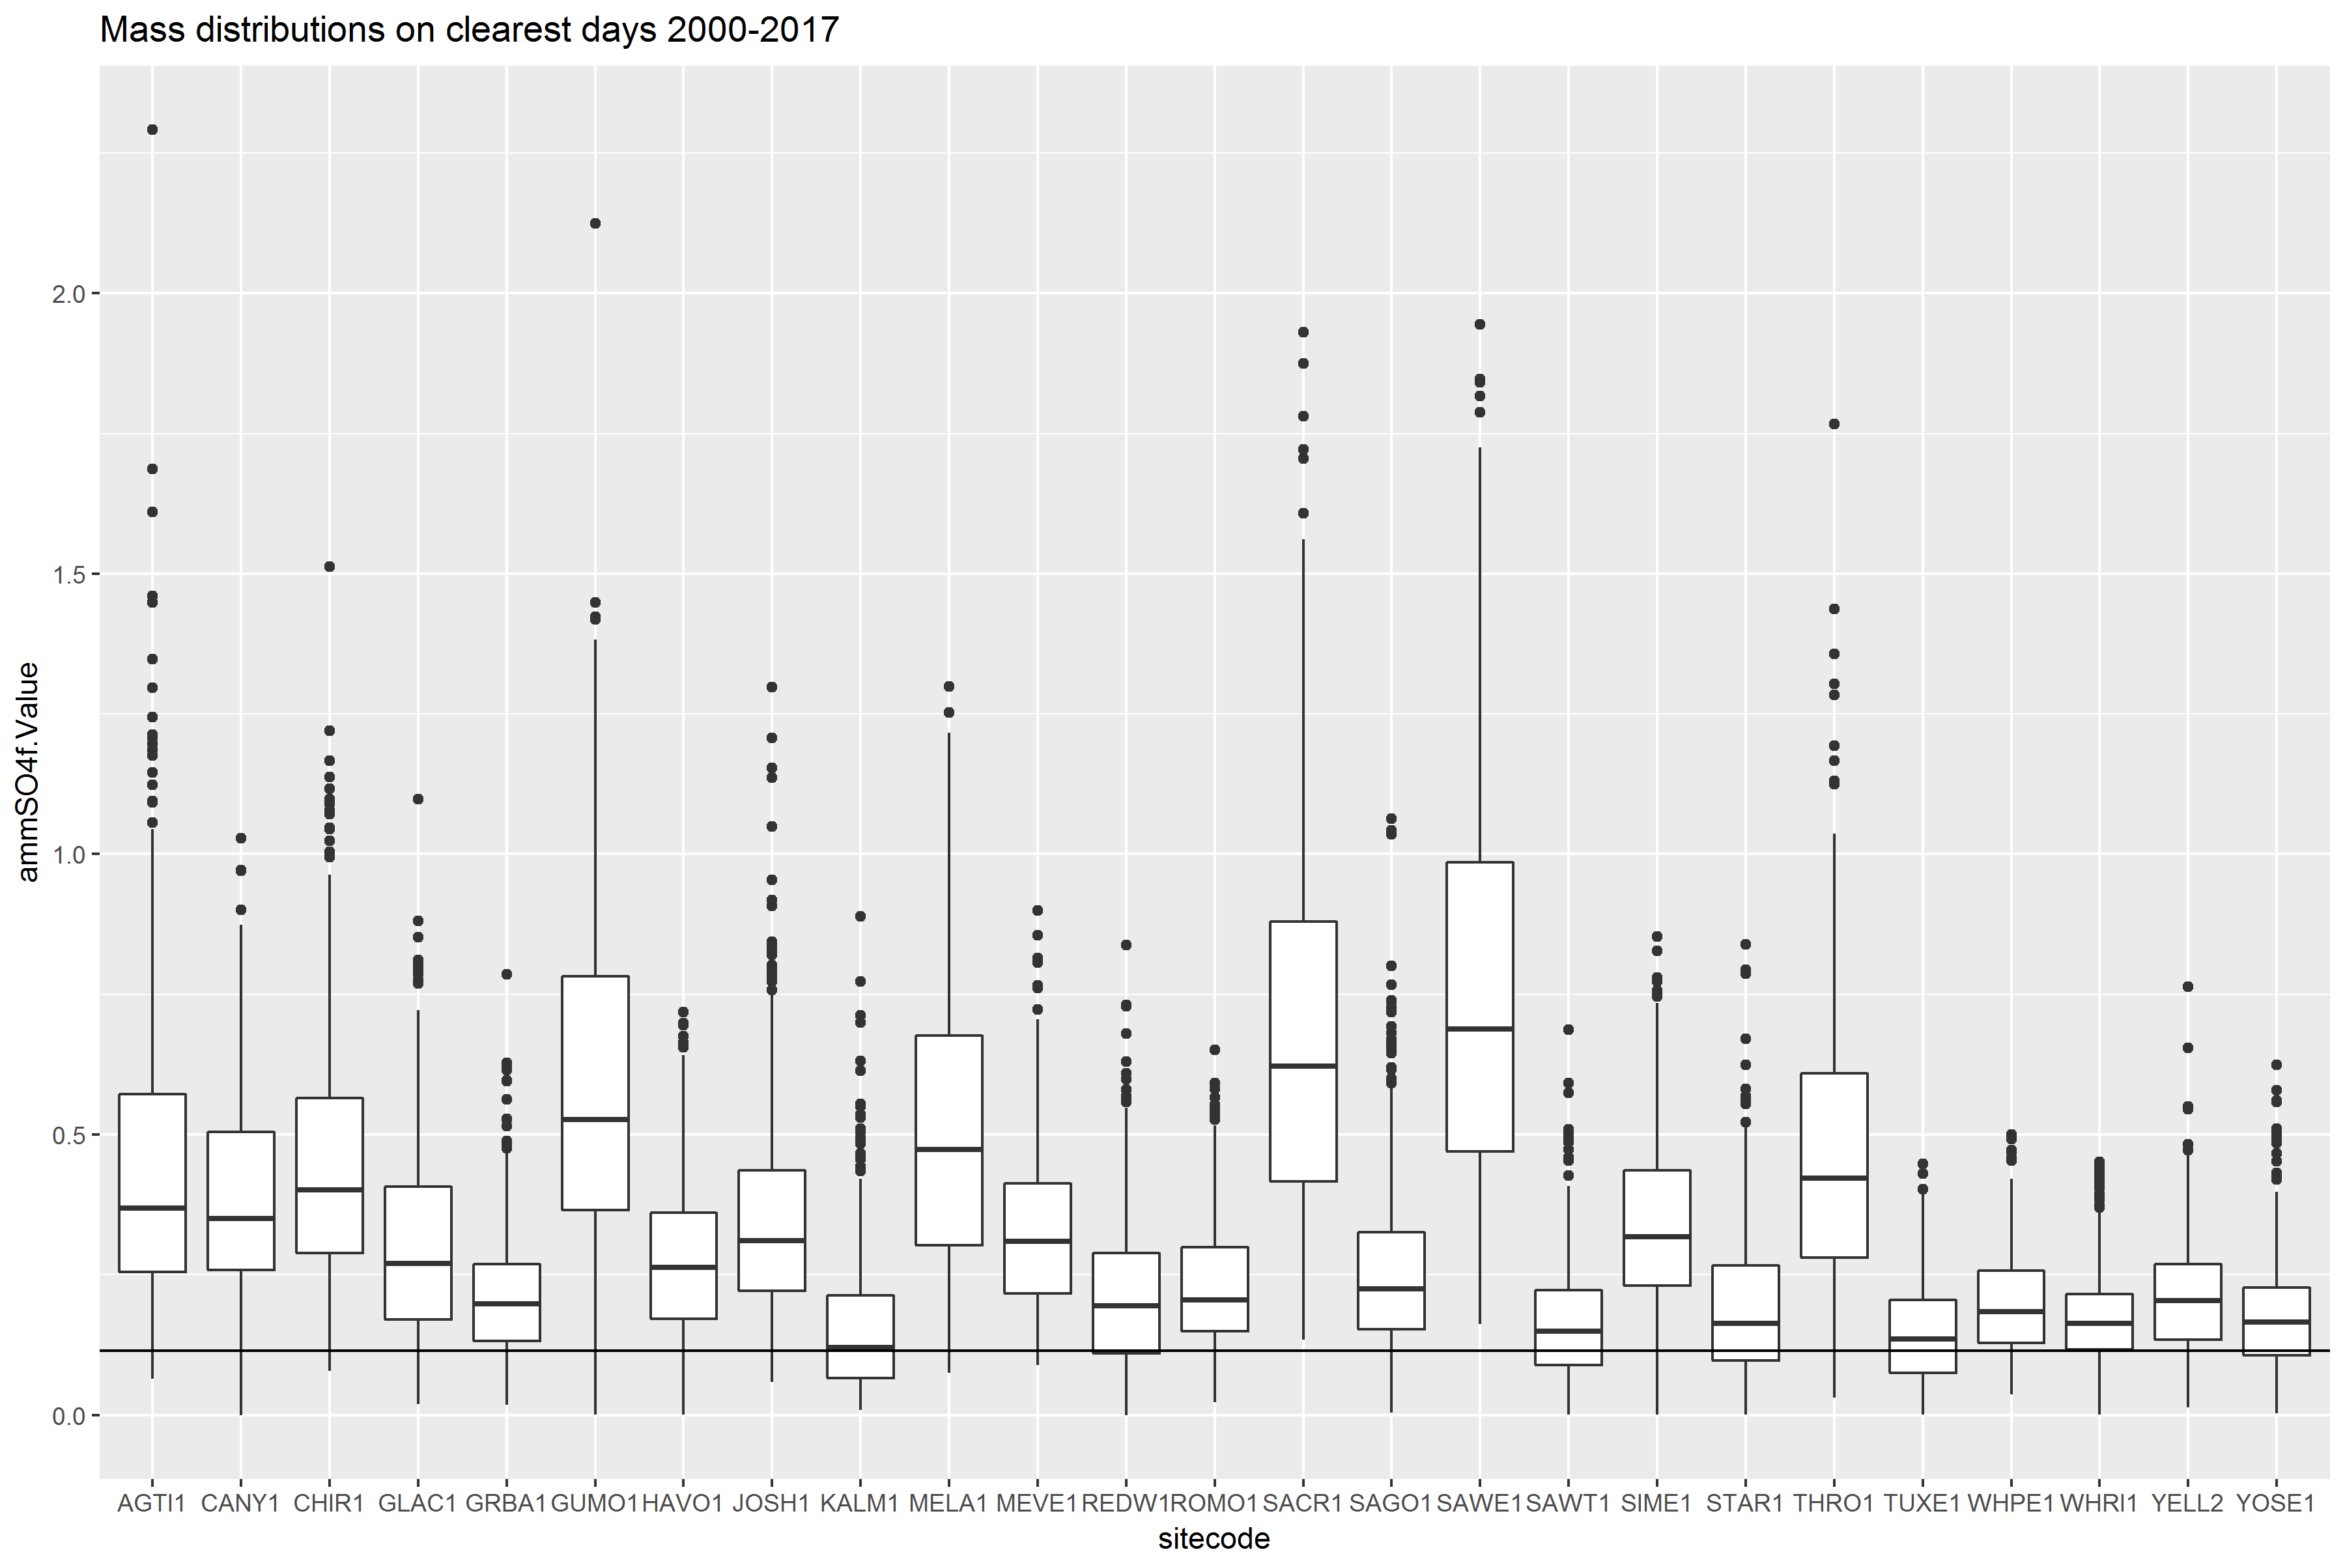
Ammonium Sulfate (µg/m³)
Trijonis #

Slide 19
 | 2064 endpoints (in deciviews) |  |  | Trijonis Values (in ug/m3)
sitecode | ep_dv_epa | ep_dv_clearest | clearest_diff | as_0.115 | an_0.1 | om_0.5994 | ec_0.02 | soil_0.5 | cm_3
AGTI1 | 7.63 | 10.86 | 3.23 | 0.351 | 0.196 | 0.122 | 0.105 | -0.126 | 0.702
CANY1 | 4.11 | 4.66 | 0.54 | 0.273 | -0.006 | -0.311 | 0.01 | -0.249 | -1.682
CHIR1 | 4.93 | 6.13 | 1.20 | 0.336 | -0.009 | -0.212 | 0.03 | -0.181 | -1.061
GLAC1 | 6.90 | 9.10 | 2.20 | 0.193 | -0.021 | 0.28 | 0.098 | -0.351 | -1.863
GRBA1 | 4.30 | 3.52 | -0.78 | 0.102 | -0.055 | -0.233 | 0.015 | -0.353 | -2.201
GUMO1 | 4.83 | 7.98 | 3.15 | 0.478 | 0.073 | -0.102 | 0.042 | 0.022 | 0.163 |  | EPA value is less
HAVO1 | 5.64 | 7.13 | 1.49 | 0.157 | -0.064 | -0.461 | -0.01 | -0.462 | -2.234 |  | EPA value is greater
JOSH1 | 6.09 | 7.37 | 1.27 | 0.244 | 0.078 | -0.153 | 0.041 | -0.15 | -0.542
KALM1 | 7.80 | 8.14 | 0.35 | 0.051 | -0.068 | 0.287 | 0.052 | -0.46 | -2.126
MELA1 | 5.95 | 8.99 | 3.03 | 0.398 | 0.065 | -0.077 | 0.031 | -0.18 | -0.16
MEVE1 | 4.20 | 4.73 | 0.53 | 0.217 | -0.007 | -0.22 | 0.019 | -0.224 | -2.051
REDW1 | 8.54 | 8.80 | 0.26 | 0.103 | -0.044 | -0.189 | 0.012 | -0.46 | -1.571
ROMO1 | 4.93 | 3.88 | -1.05 | 0.117 | -0.051 | -0.339 | 0.004 | -0.364 | -2.068
SACR1 | 5.50 | 9.91 | 4.41 | 0.562 | 0.202 | 0.076 | 0.063 | 0.099 | 2.067
SAGO1 | 6.19 | 6.43 | 0.24 | 0.15 | 0.059 | -0.227 | 0.035 | -0.295 | -1.48
SAWE1 | 5.21 | 9.43 | 4.22 | 0.645 | 0.169 | 0.18 | 0.108 | 0.687 | 2.189
SAWT1 | 4.67 | 4.91 | 0.24 | 0.056 | -0.067 | 0.077 | 0.022 | -0.382 | -2.524
SIME1 | 8.49 | 9.82 | 1.33 | 0.226 | -0.058 | -0.432 | 0.027 | -0.469 | -1.147
STAR1 | 6.59 | 5.71 | -0.88 | 0.085 | -0.045 | -0.246 | 0.009 | -0.405 | -2.375
THRO1 | 5.93 | 8.70 | 2.77 | 0.351 | 0.04 | -0.045 | 0.057 | -0.196 | 0.112
TUXE1 | 6.96 | 6.29 | -0.67 | 0.034 | -0.07 | -0.492 | -0.009 | -0.467 | -2.359
WHPE1 | 3.53 | 2.42 | -1.11 | 0.09 | -0.052 | -0.386 | 0.009 | -0.373 | -2.285
WHRI1 | 3.02 | 1.73 | -1.29 | 0.062 | -0.055 | -0.476 | 0.01 | -0.398 | -2.612
YELL2 | 3.98 | 3.48 | -0.50 | 0.098 | -0.019 | -0.313 | 0.002 | -0.425 | -2.618
YOSE1 | 6.29 | 4.60 | -1.69 | 0.065 | -0.045 | -0.27 | 0.008 | -0.407 | -2.227
Colored cells represent difference amounts
Left side of the table:
Endpoints using EPA assumptions and “clearest as natural” assumptions
Right side of the table
Headings represent Trijonis values
Cell values represent the difference between the Trijonis value and the “clearest as natural value”
(Trijonis minus “can”)

Slide 20
Alternate Trijonis numbers
What the “clearest days as natural” assumption suggests:
Ammonium sulfate and elemental carbon Trijonis values too low
Coarse Mass and Soil Trijonis values too high
Ammonium nitrate and organic mass are more site-dependent (could not generalize)
Question:
Are clearest days the best representation of natural-routine?

Slide 22
Observations
“Clearest” days are getting “clearer”
The clearest days concentrations are trending downward, so they may not serve as a good natural conditions estimate
Are natural conditions changing?

Slide 23
Metric Topics
Metric run-through
Alternate Trijonis values
Future episodic scenarios

Slide 24
Future wildfire scenarios
Questioned: how does metric treat elevated carbon impacts in those future scenarios, simulating a high wildfire year (while other species kept their progress towards natural)?
In the scenario shown in the following slides, we simulated a uniform reduction of all species, while holding episodic carbon species constant, to see how the glidepath and MIDs looked

Slide 25
Future wildfire scenarios
GLAC1: assume constant rate of decrease of every species, to their NCII values in 2064
EXCEPT for any episodic carbon, as determined by the metric in 2017
Hold the portion of the carbon concentration allocated episodic as constant, reduce all other species uniformly to their NCII values
Some of the carbon will get reassigned from year to year as the other non-episodic carbon gets reduced, but the raw amount determined from 2017 is constant
In order to simulate elevated future episodic carbon (during fire season), while allowing all other species to gradually improve

Slide 26
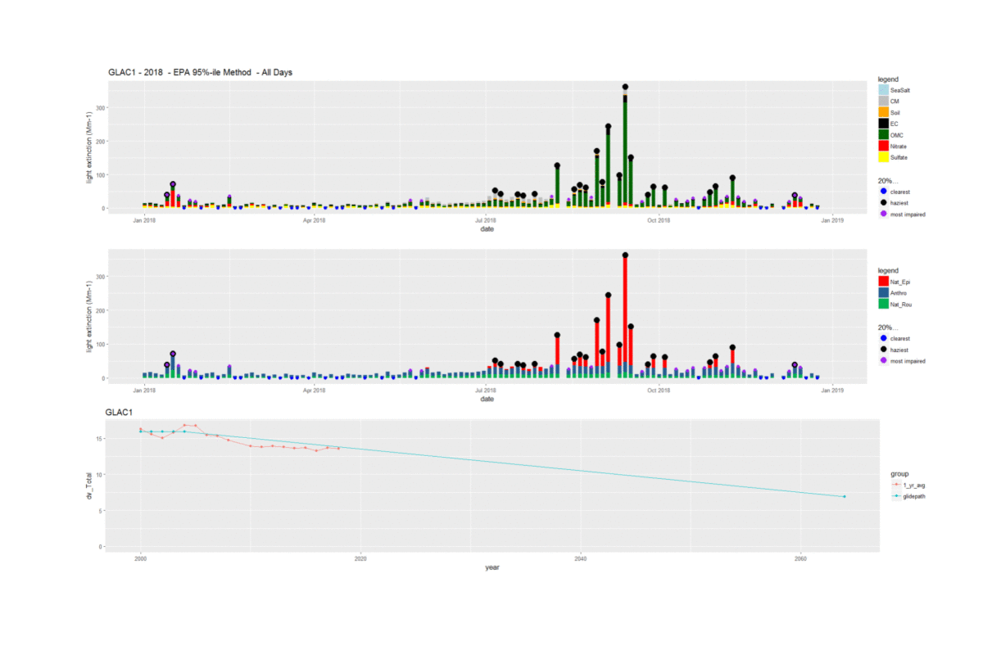

Slide 27
Notes
As time goes on, more of the most impaired days start to get assigned to the days with episodic carbon (that raw carbon concentration is held constant)

Slide 28
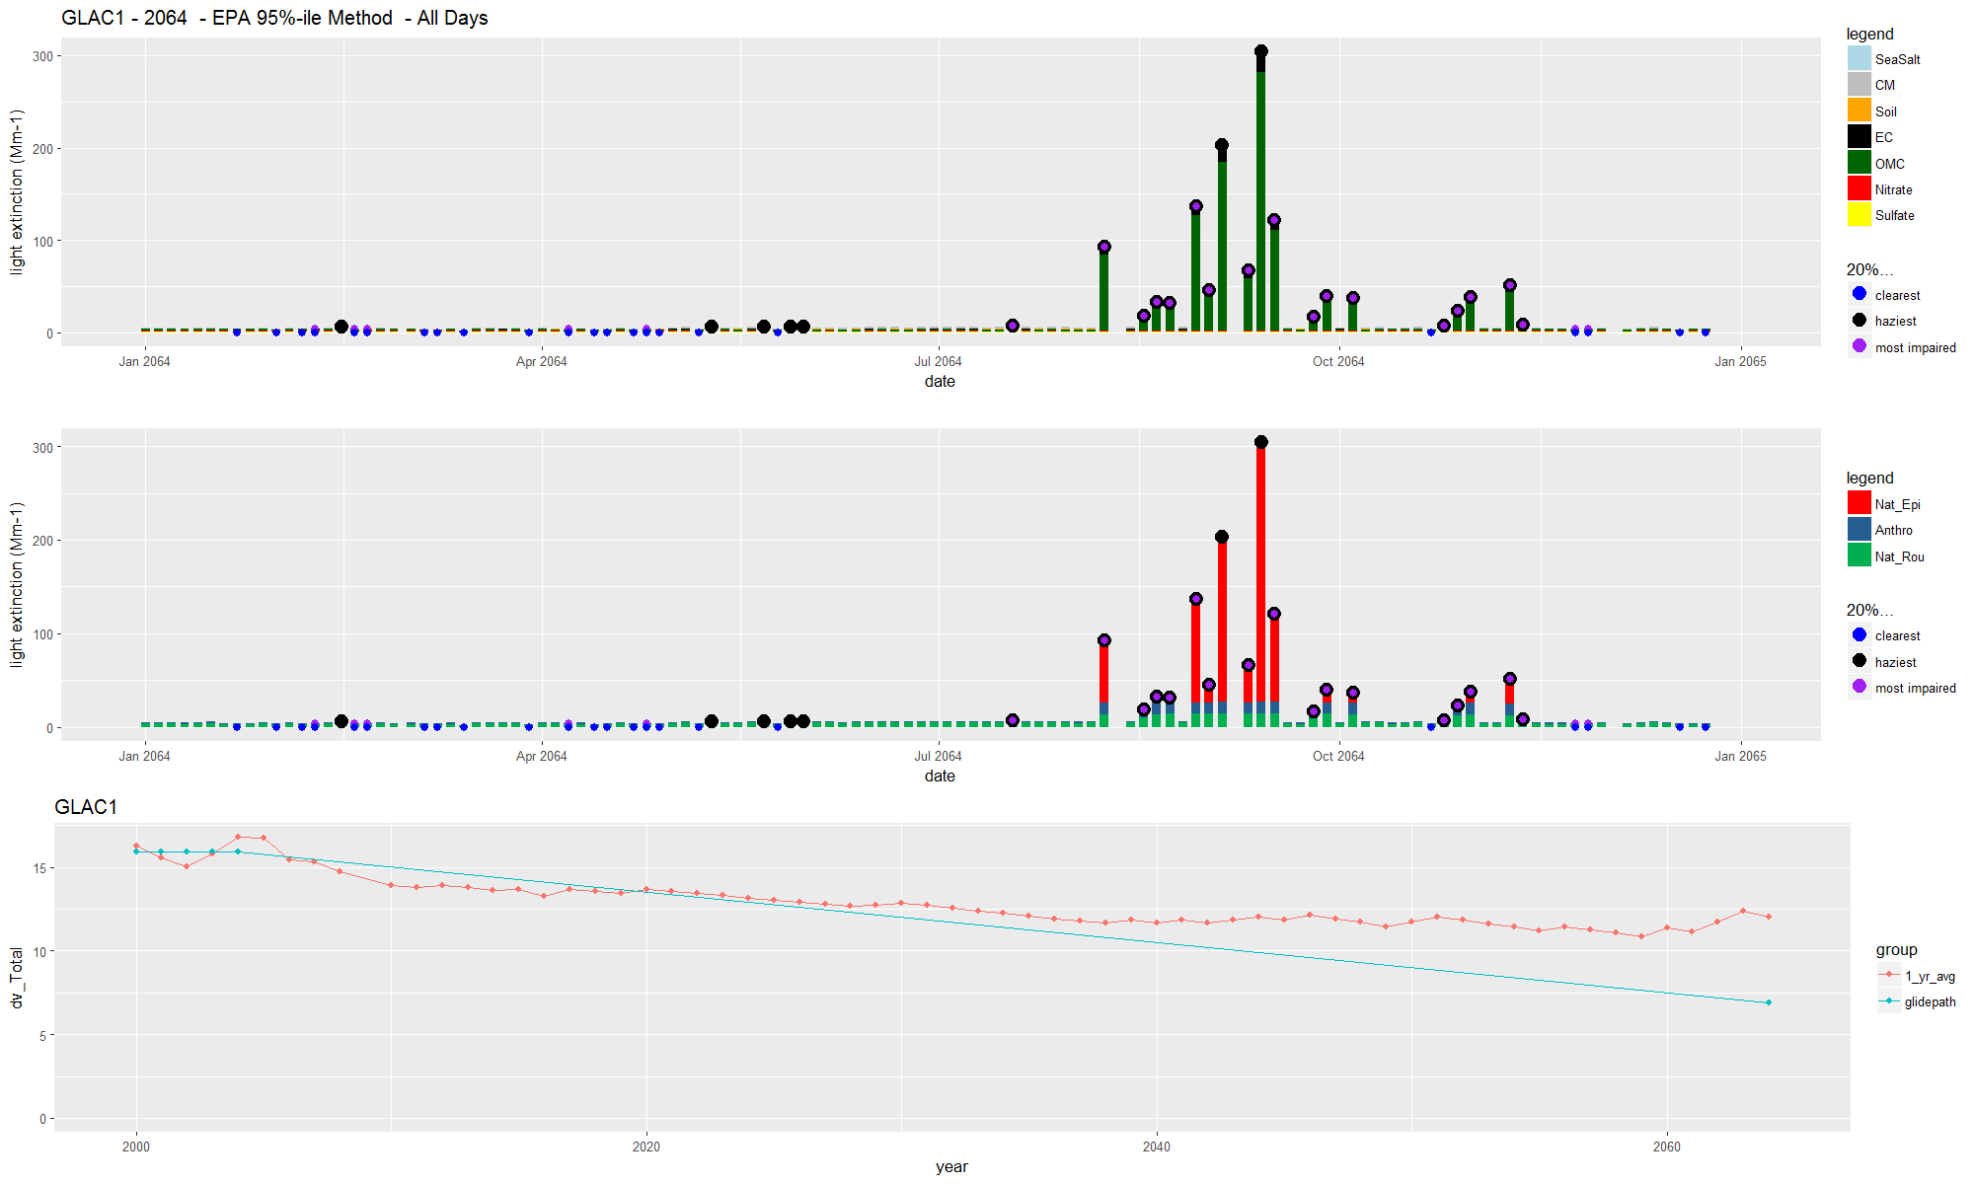
many episodic days are most impaired
Flatter progress

Slide 29
Wildfire scenarios conclusions
Assuming every future year is a bad wildfire year is probably crude, but it still can be illustrative for showing isolated high wildfire years in the future
Improvements can be made going toward 2064 goals, but the metric may not adequately handle episodic days in the future
The metric assigns anthropogenic to any day with episodic contributions
Although this is handled adequately in years with elevated concentrations that are not episodic (because of the ranking based on deciview instead of on light extinction), in future years where the non-episodic concentrations are expected to lower, the anthropogenic contribution on episodic days becomes significant

Slide 30
Overview for next steps
Natural-routine analysis
Natural conditions may not be constant
Seasonal values
Have natural-routine account for seasonal variations
Regional values (instead of just East and West)
Can current modeling, emissions inventories, and monitoring data combined help better estimate natural?
Zero out anthropogenic emissions scenarios (call the rest natural)?
Can work of Schichtel, et. al. be expanded on with new modeling results? (Schichtel, B.A, Rodriguez, M.A., Barna, M.G., Gebhart, K.A., Pitchford, M.L., Malm, W.C. A semi-empirical, receptor-oriented Lagrangian model for simulating fine particulate carbon at rural sites. Atmos.Environ., 61, 361- 370, 2012.) See EPA’s TSD for evaluation, concluded that modifications do not significantly alter deciview trends… will this become important as anthropogenic contributions decrease?
Future wildfire scenarios
Consider revising metric to account for future high episodic contributions
Anthropogenic assignment on wildfire days become significant as concentrations reduce on non-episodic days
As suggested in EPA’s TSD, consider all contributions as natural on episodic days in future planning periods?

Slide 31
Data Topics
Threshold Adjustment
Part 2: Species-specific data trends

Slide 32
Threshold adjustment: Case Study Comparison
Agua Tibia Wilderness (AGTI1)
Southern California
Monitor elevation ~500 meters within coastal marine inversion, 50 km from ocean
5,934 acres
Inside Cleveland National Forest at southern crest of mountains ringing Los Angeles Basin at northern edge of San Diego County
Wilderness characterized by chaparral, fir, pine, and oak on mountains in hot dry climate with no permanent streams
Between Los Angeles (pop. 18 million) Extreme ozone and Moderate PM2.5 and San Diego (pop. 3 million) Moderate ozone non-attainment areas
Sawtooth Wilderness (SAWT1)
Central Idaho
Monitor elevation ~1900 meters in valley subject to smoke-trapping inversions
217,088 acres
Western wilderness portion of Sawtooth National Recreation Area characterized by granite peaks, high alpine lakes, multiple streams, narrow glacial valleys with enormous stands of trees
Remote from major source regions
Boise (population 227,000) 180 km south of Sawtooth separated by mountain range
Over 300 km to nearest non-attainment area

Slide 33
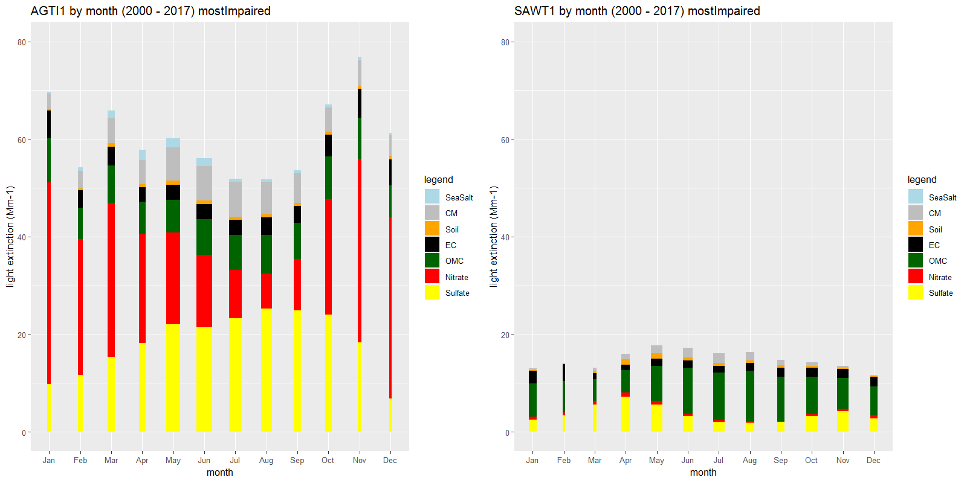
Species concentrations by month

Slide 34
Species concentrations by month
Shows the species averages by month on MIDs, 2000-2017
Width of each bar is proportional to the number of MIDs in that month
Plots show both the magnitude differences and the seasonal differences in the two sites
AGTI1 has a significant nitrate and sulfate contribution, MIDs tend to be early summer months
SAWT1 has very little nitrate, and fairly constant organic carbon contribution, MIDs tend to be summer/fall months
Sulfate patterns are opposite at these sites

Slide 35
Threshold adjustment
Put the data through EPA’s metric
Varied the percentile threshold for episodic
60→100%-ile in 1 %-ile increments
Looked at how the anthropogenic and natural split depended on the threshold
Especially the carbon (episodic wildfire) species
Looked at two sites that show much different behavior
AGTI1
SAWT1

Slide 36
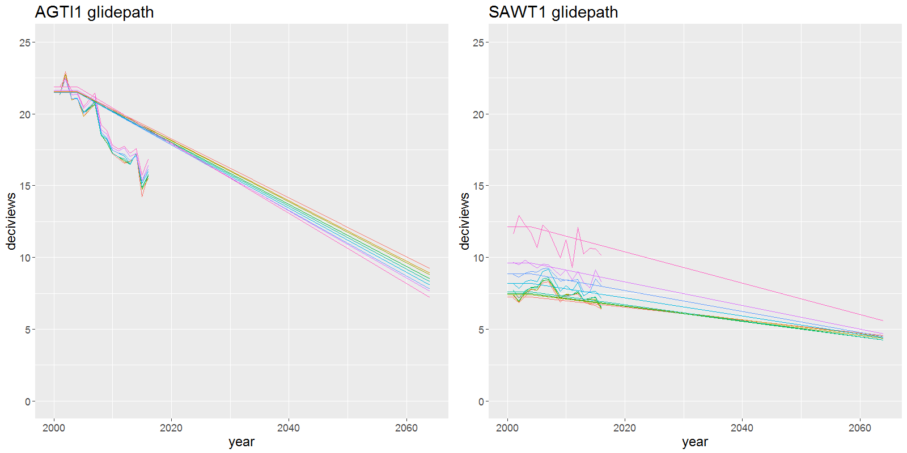
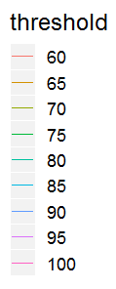
Glidepaths

Slide 37
Glidepaths
Shows the different glidepaths for select thresholds
Notable:
Magnitude differences in baseline and endpoint deciviews
The sensitivity differences to varying thresholds
In progress lines and their characteristics
AGTI1 maintains same shape
SAWT1 progress is more dependent on threshold
In endpoints
AGTI1 endpoints spread over a couple deciviews
SAWT1 endpoints less affected by threshold (except for the 100% threshold case)

Slide 38
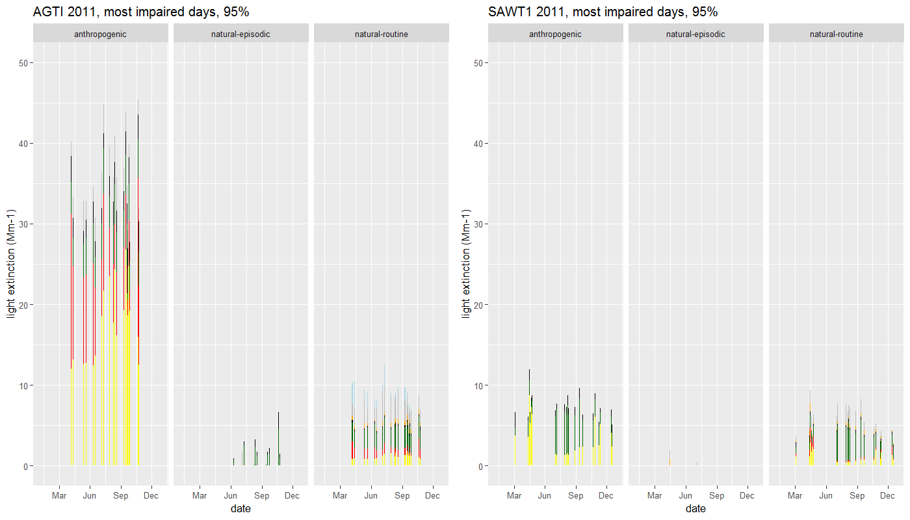

Slide 39
Sample year - 2011
Graph shows most impaired days at both sites for 2011
Notice magnitude and species contributions
Shows the seasons when the MIDs
How the anthropogenic/natural breakdown looks
AGTI1 shows larger anthropogenic components
SAWT1’s anthro is much lower, more comparable to natural-routine
SAWT1 data may be “buried” in the noise of natural-routine, more sensitive to appropriate NCII values

Slide 40
Carbon vs. threshold (MIDs)

Slide 41
Carbon vs. threshold (MIDs)
Look at the anthropogenic-natural split in carbon contributions on MIDs
Sites show different behavior in the natural portion
AGTI1, shows natural generally decreasing with increasing threshold (more carbon gets allotted away from episodic and towards anthropogenic)
SAWT1, shows natural generally increasing with increasing threshold (something different is going on… episodic should be decreasing, but something else is causing the increase)
See circled portion of SAWT1, 2011, where the plot starts to increase

Slide 42
All species vs. threshold (MIDs)

Slide 43
All species vs. threshold (MIDs)
Look at the anthropogenic-natural split at all species
Both sites show similar trends in anthropogenic
Natural shows different behavior, especially after about 80-90%-ile – looks to be dominated by carbon

Slide 44
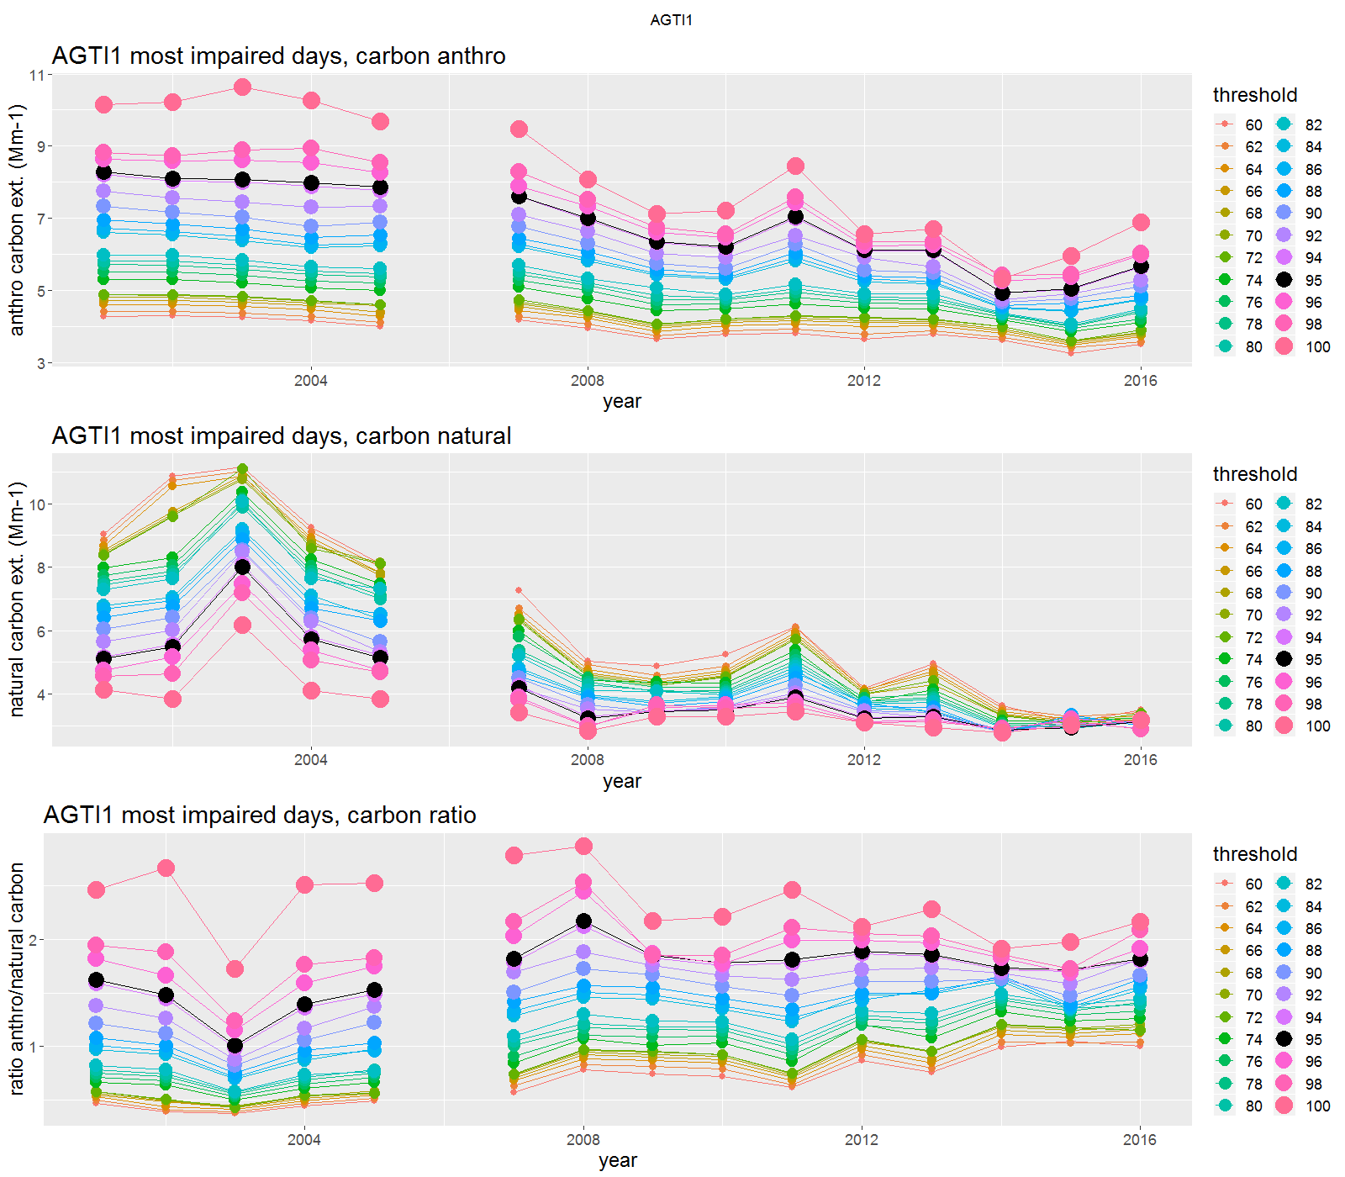
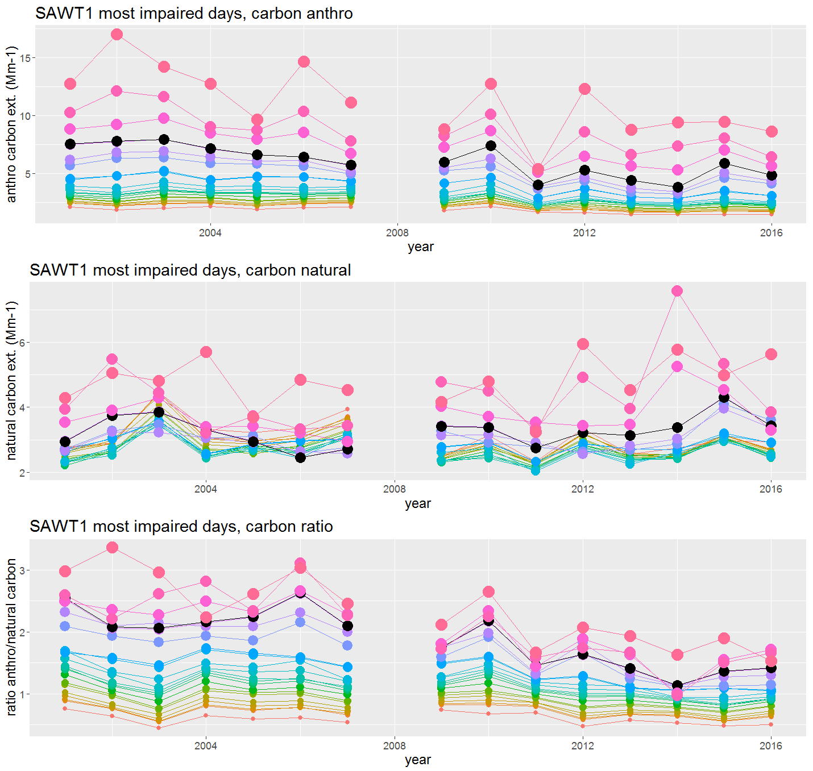
Carbon assignments by year (MIDs)

Slide 45
Carbon assignments by year (MIDs)
A look the carbon assignment, by year and threshold
Anthropogenic
Natural
Ratio of anthropogenic to natural
Sites show generally similar trends, but SAWT1 is much more erratic
Especially in the natural allotment
Amplifies the sensitivity of the natural assignment to threshold adjustments

Slide 46
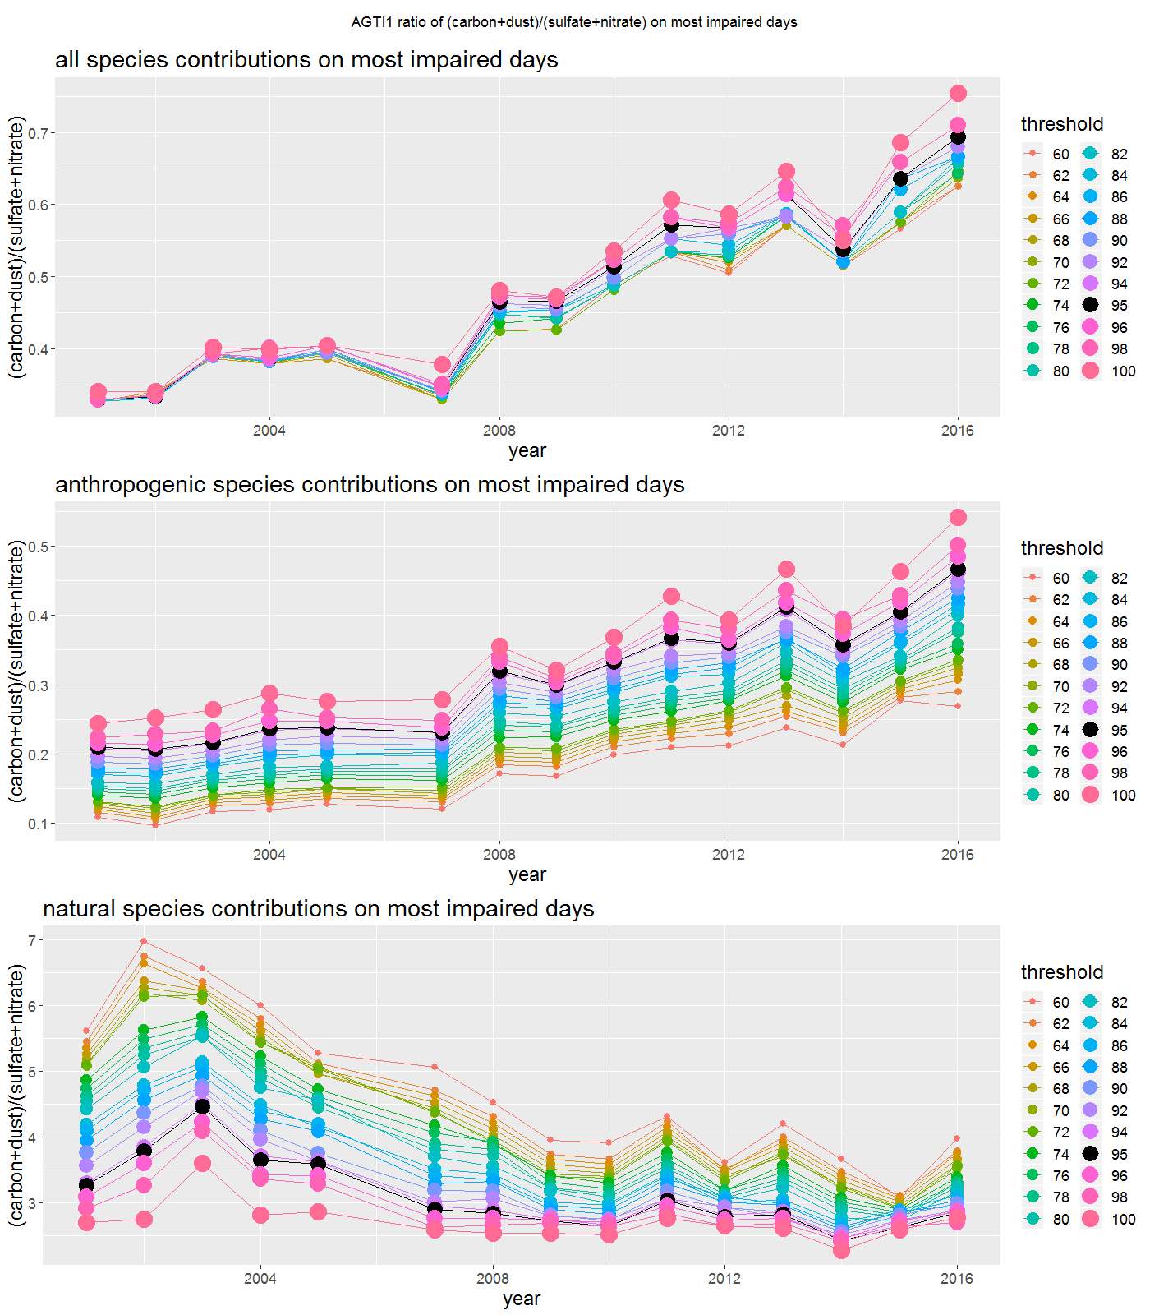
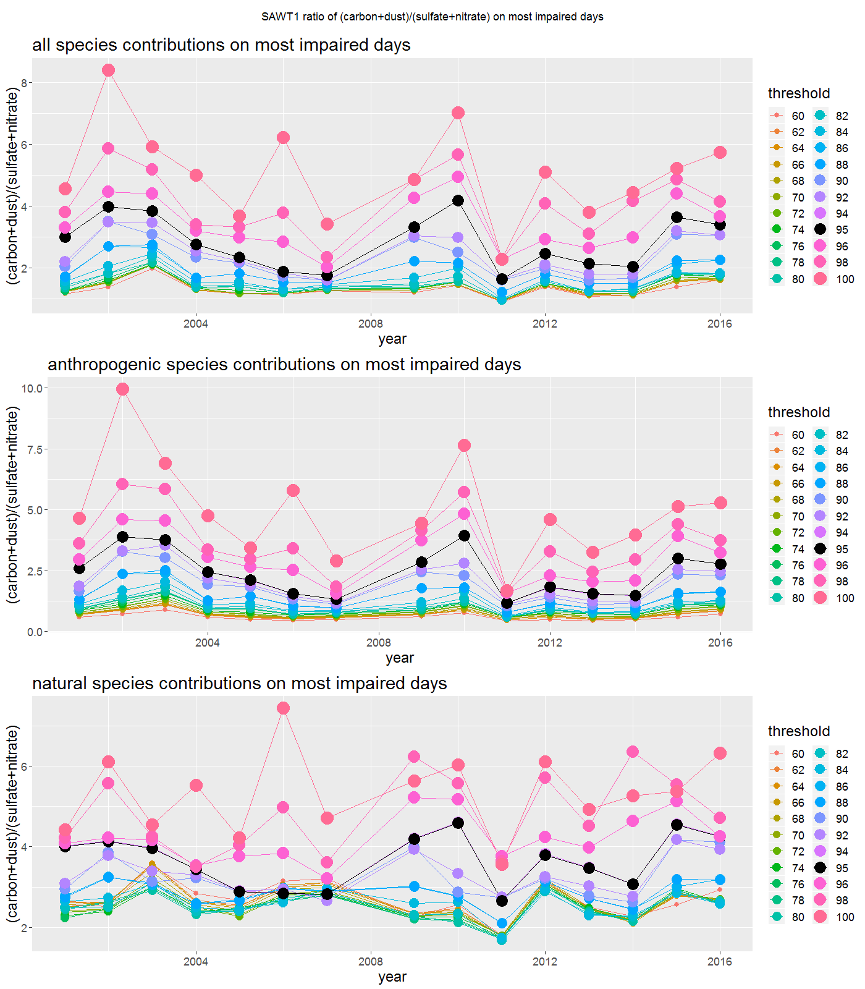
(Carbon+Dust)/(Nitrate+Sulfate) ratios (MIDs)

Slide 47
(Carbon+Dust)/(Nitrate+Sulfate) ratios (MIDs)
Looked at ratio for all species types (anthro/natural), and by anthropogenic and natural separately
The idea was that if the “right” threshold was chosen, the anthropogenic ratios would show more “normal” behavior
Like the carbon-only breakdowns, these plots show the “stability” of AGTI1 with respect to threshold (notice y-axis scales)
On the contrary, these plots amplify the sensitivity of SAWT1 to threshold

Slide 48
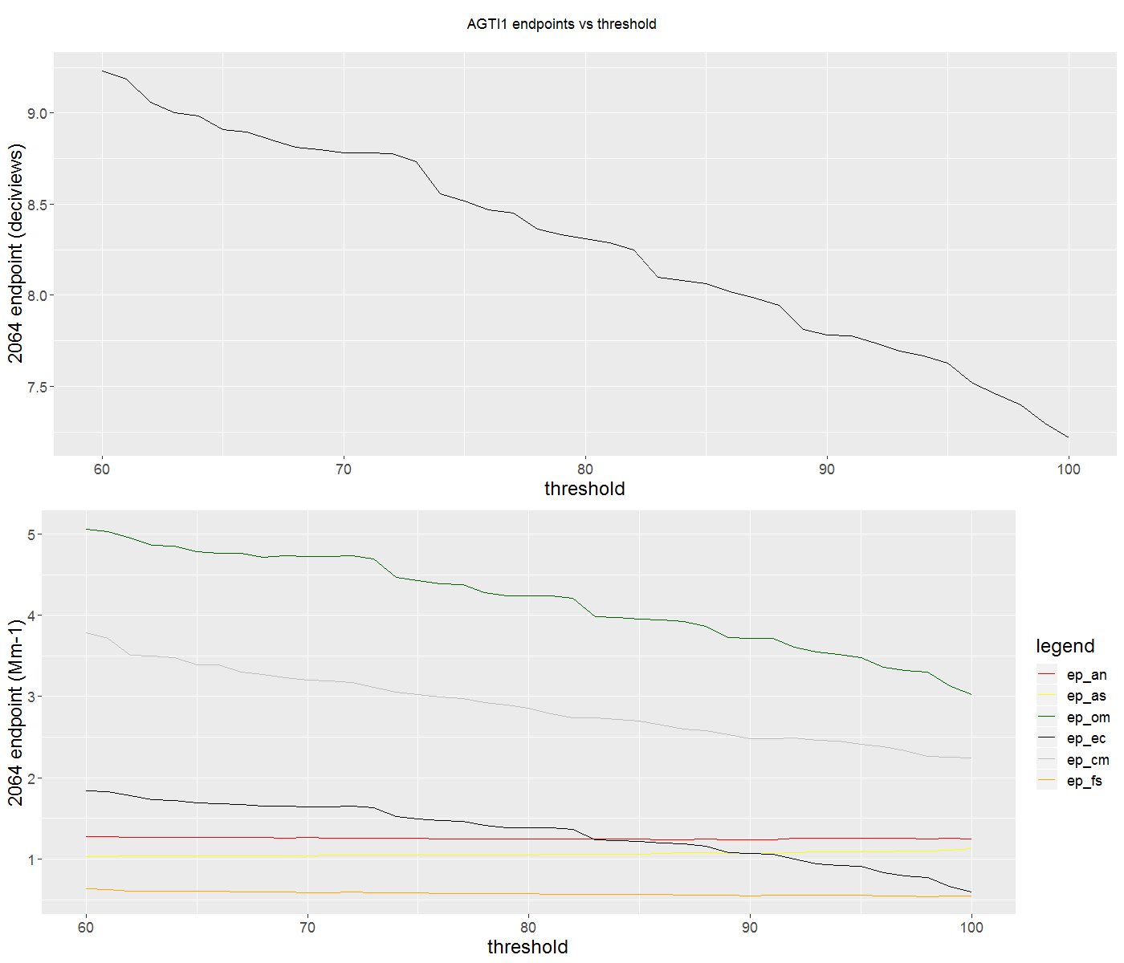
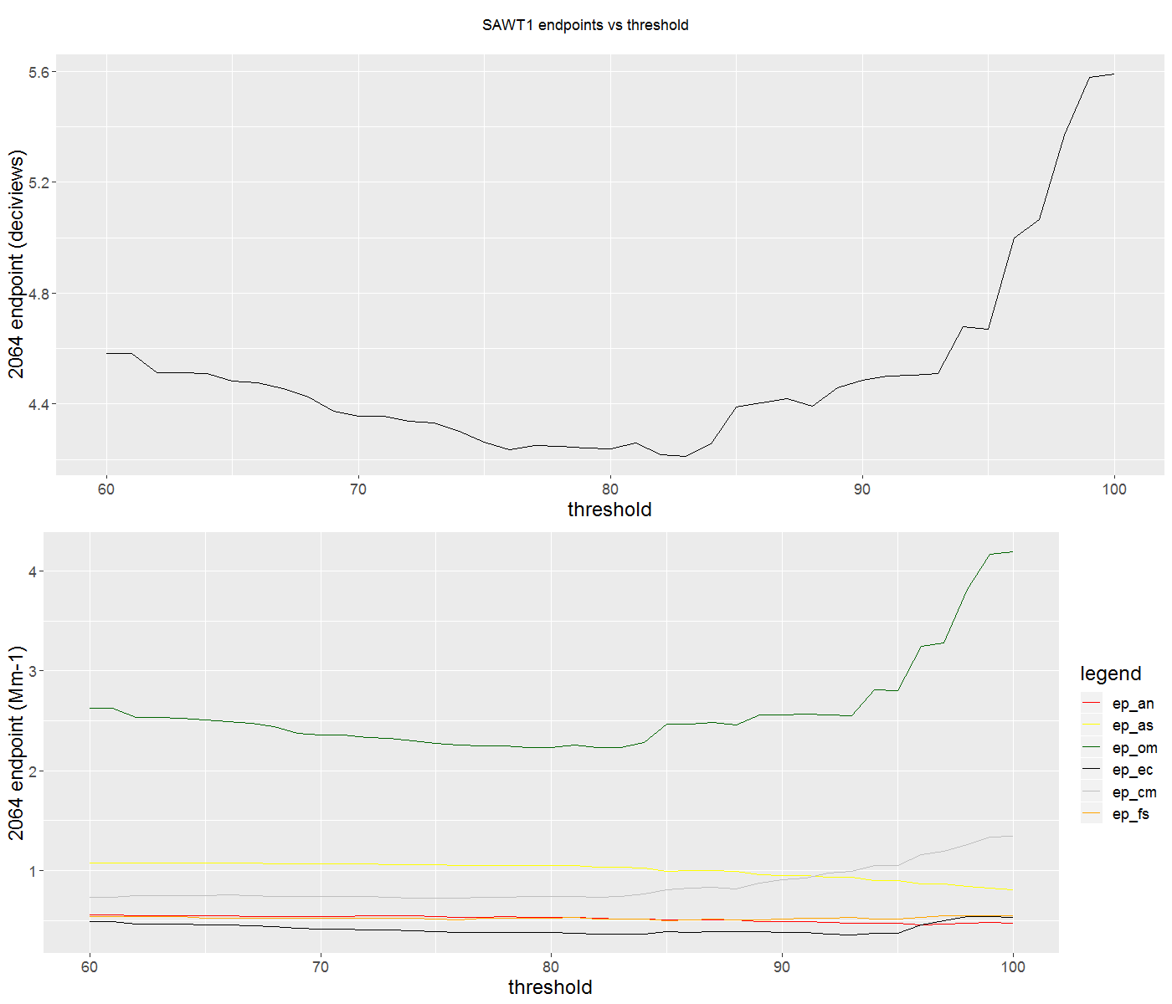
How 2064 Endpoint changes with threshold

Slide 49
How 2064 Endpoint changes with threshold
Sites show different behavior
AGTI1, endpoint gradually reduces with increasing threshold
SAWT1, endpoint reduces, then turns around at around 80%
Species specific contributions highlight which species contribute to the deciview endpoint trends

Slide 50
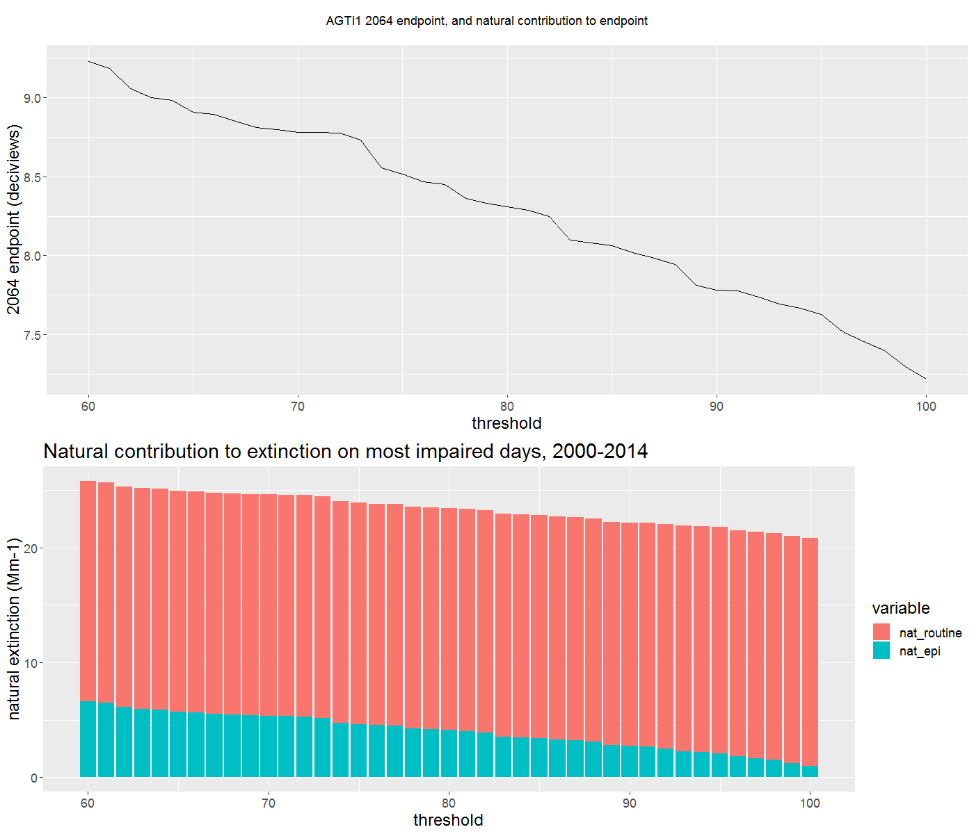
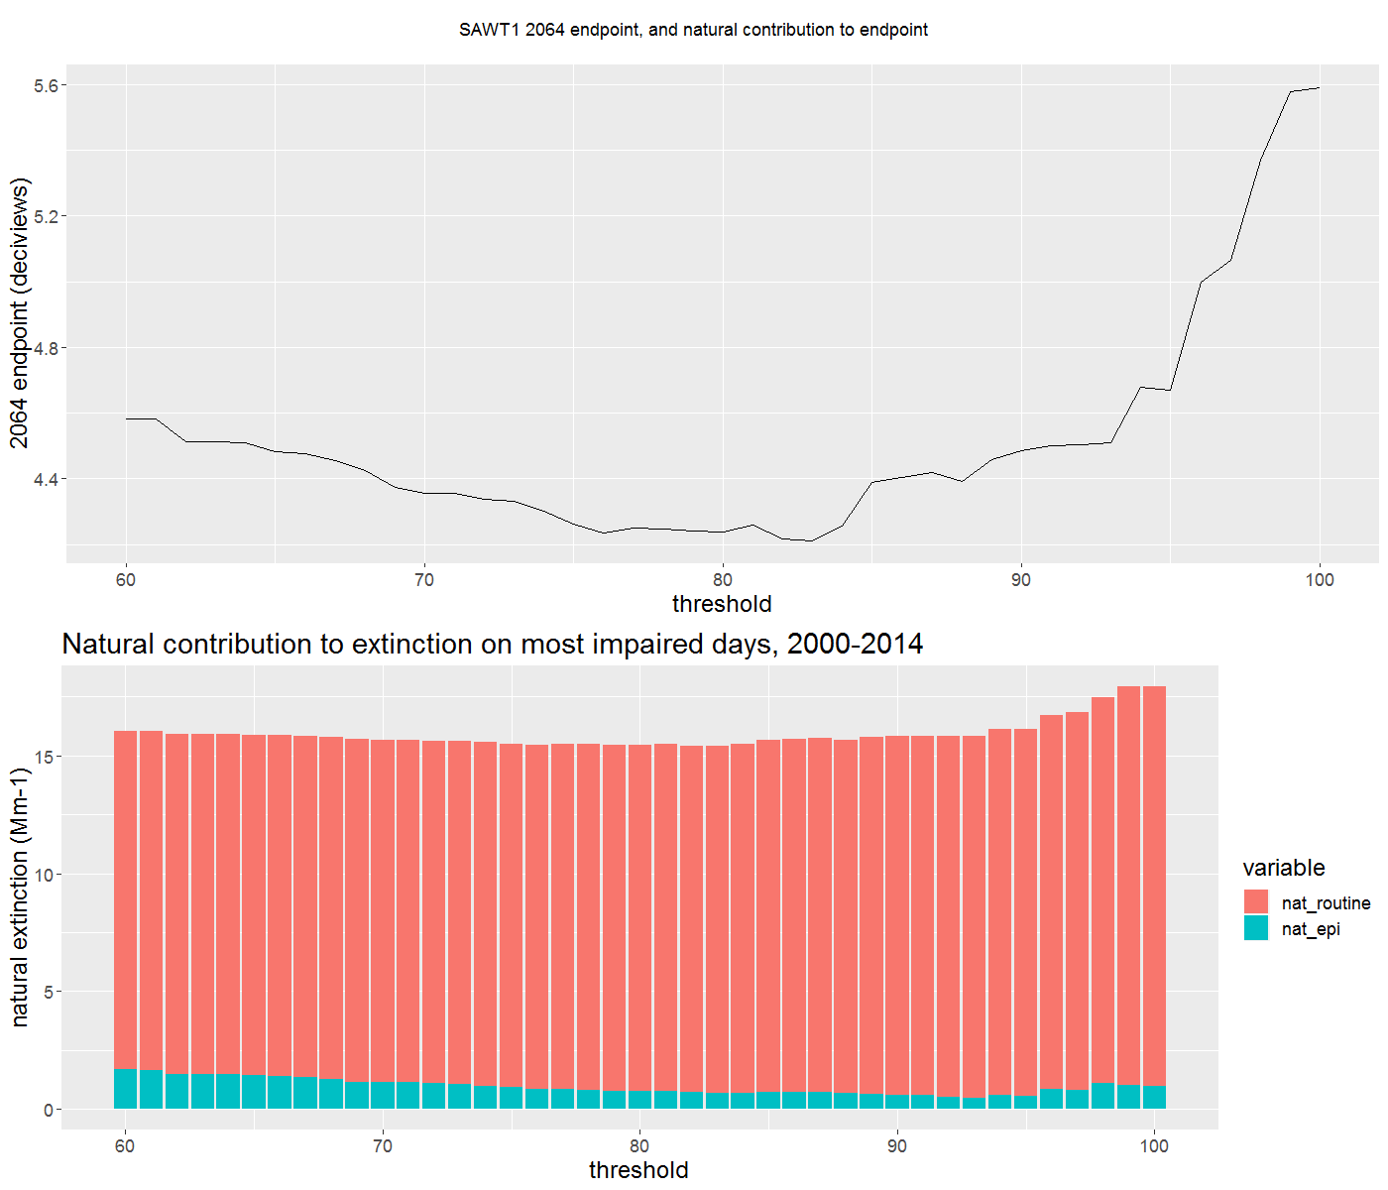
2064 Endpoint vs. threshold, natural split

Slide 51
2064 Endpoint vs. threshold, natural split
Sites show different behavior in the natural-routine and natural-episodic split
AGTI1, episodic gradually decreases, routine fairly constant, overall dominated by episodic contribution
SAWT1, shows similar behavior at first, then episodic and routine grow considerably somewhere between 80-90%-ile

Slide 52
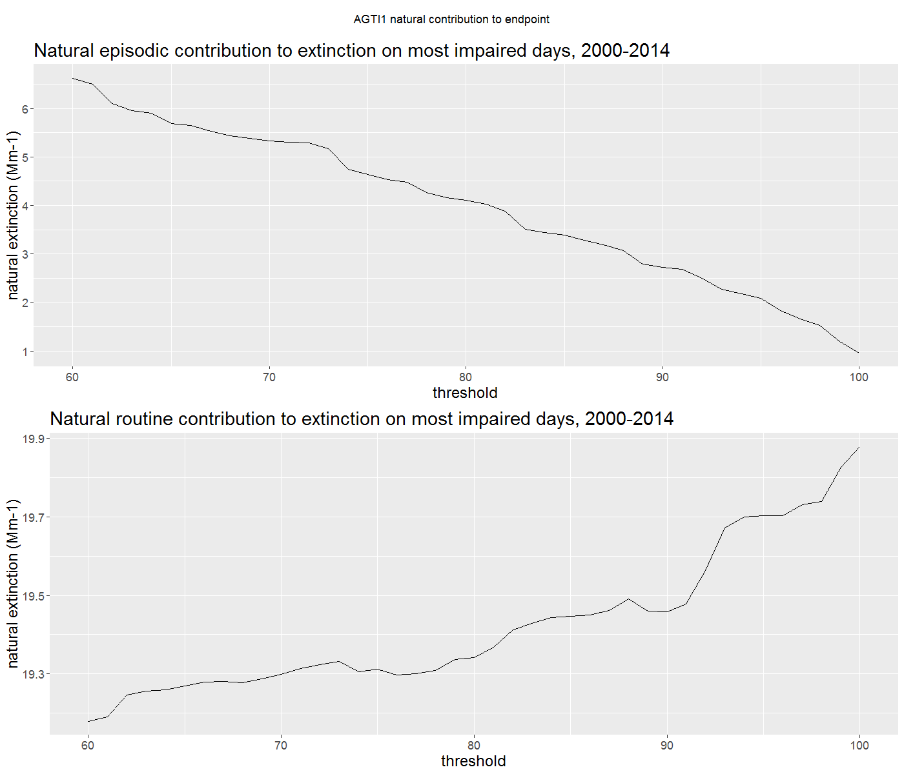
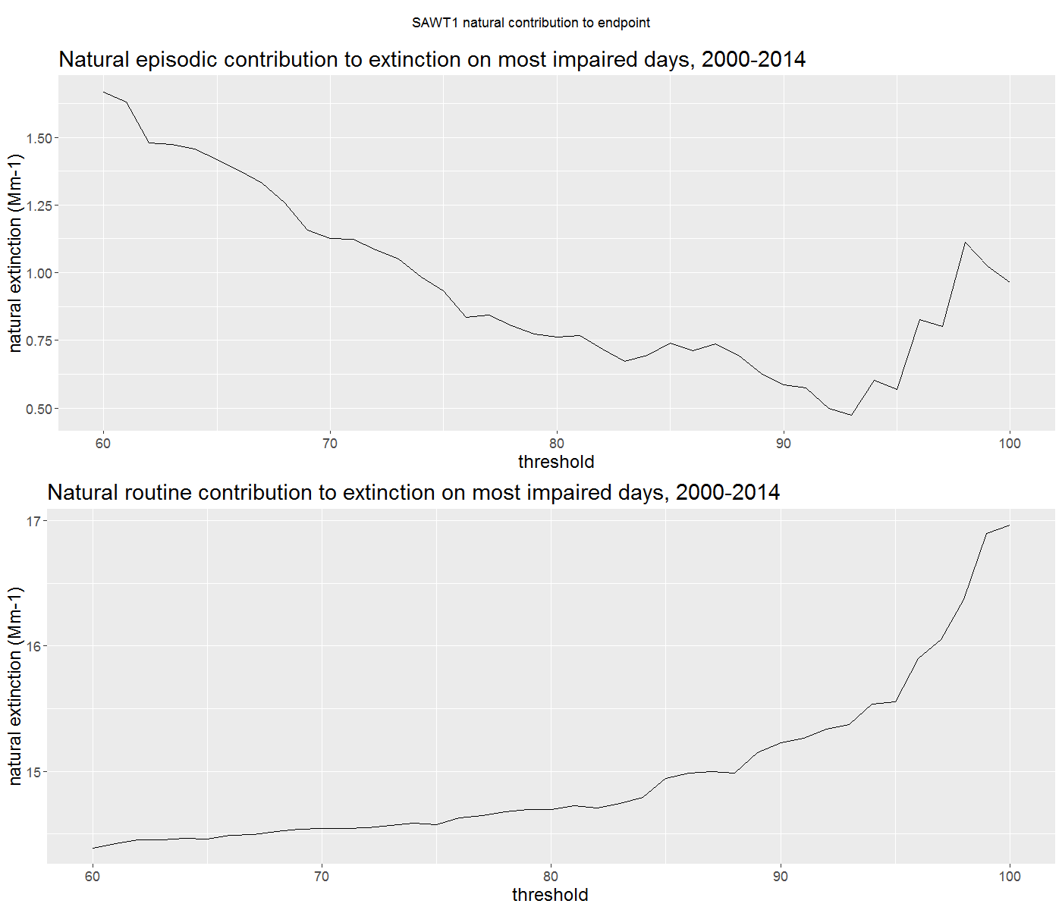
Routine and episodic vs. threshold

Slide 53
Routine and episodic vs. threshold
Illuminates what was shown on the previous slide
Notice the y-axis differences between the 2 sites, especially on the natural-routine slide
AGTI1 natural-routine shows very gradual increase
SAWT1 natural-routine starts out gradual, then climbs much quicker somewhere between 80-90%-ile

Slide 54
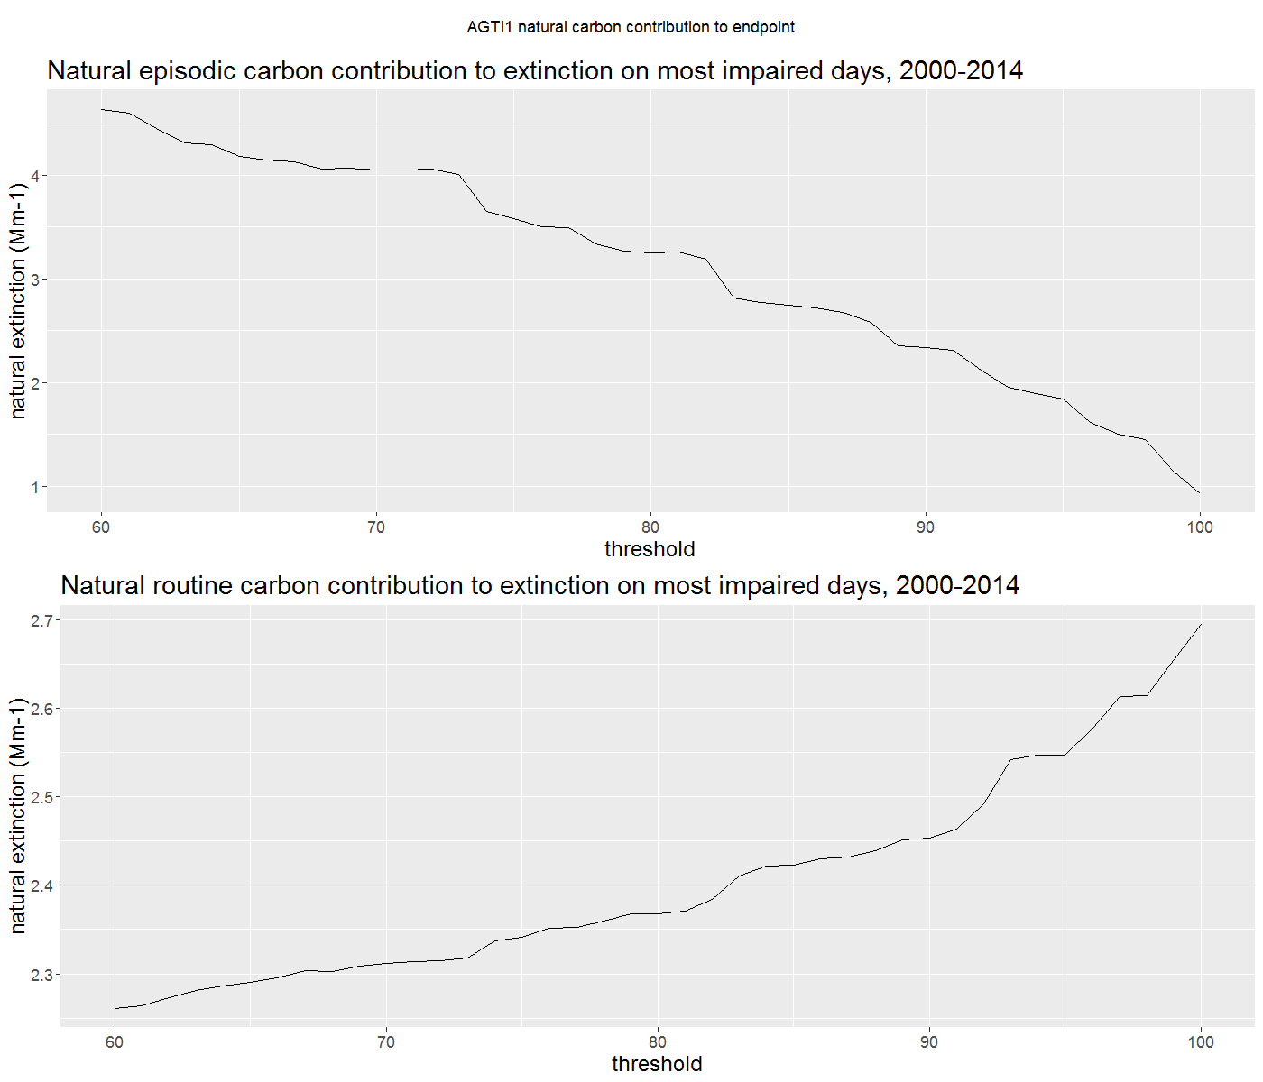
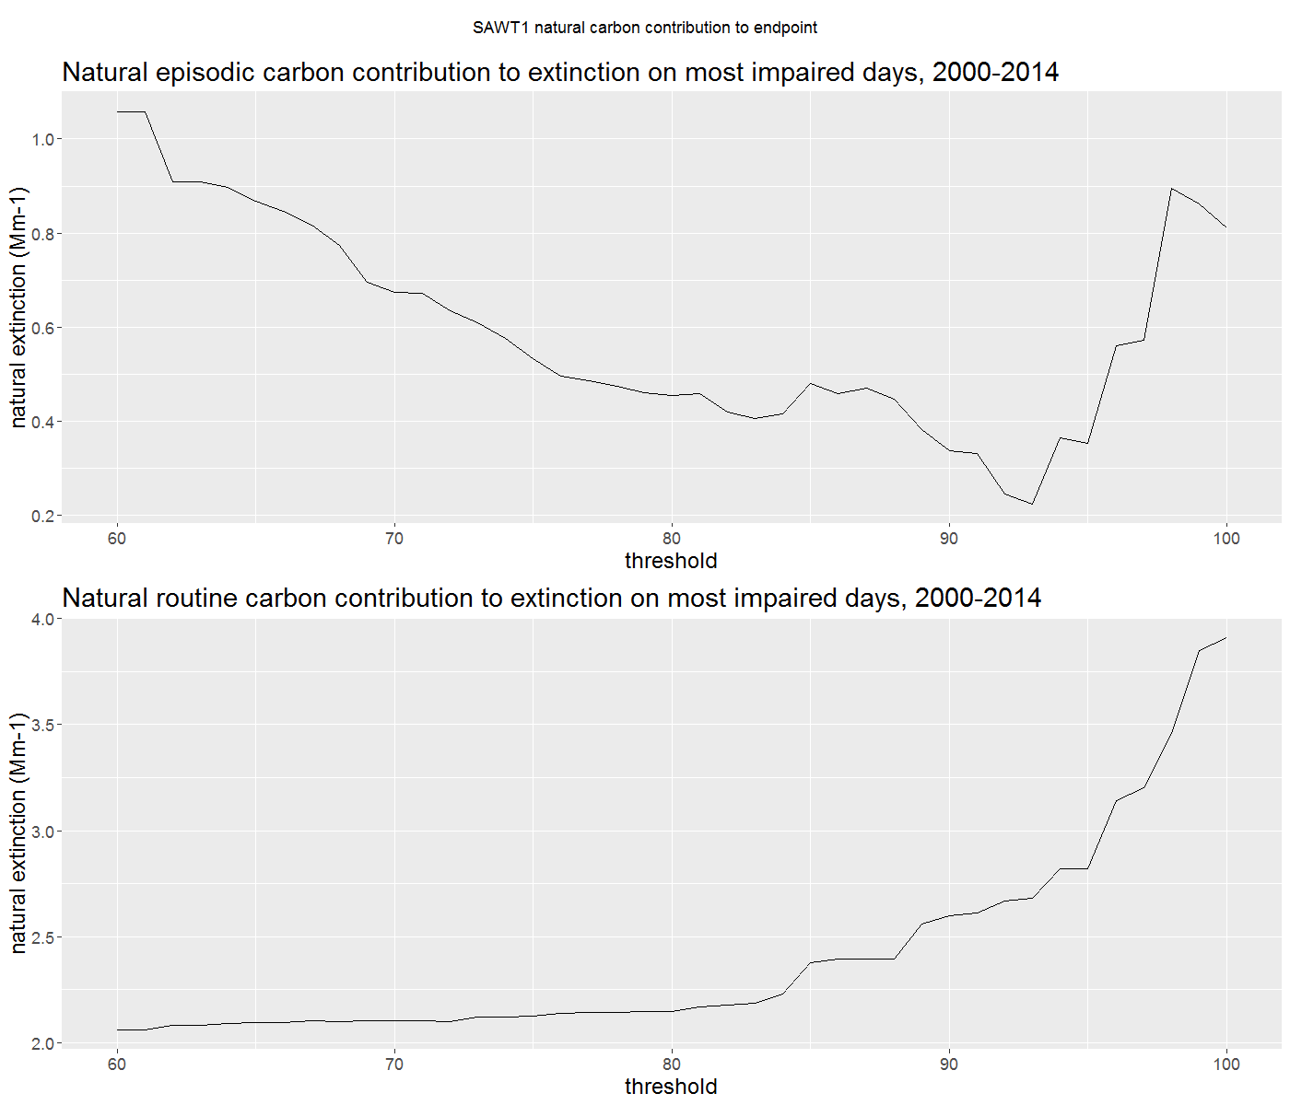
Routine and episodic carbon vs. threshold

Slide 55
Routine and episodic carbon vs. threshold
Looked at carbon, due to it’s role in episodic contributions
Illustrates similar points as previous slides

Slide 56
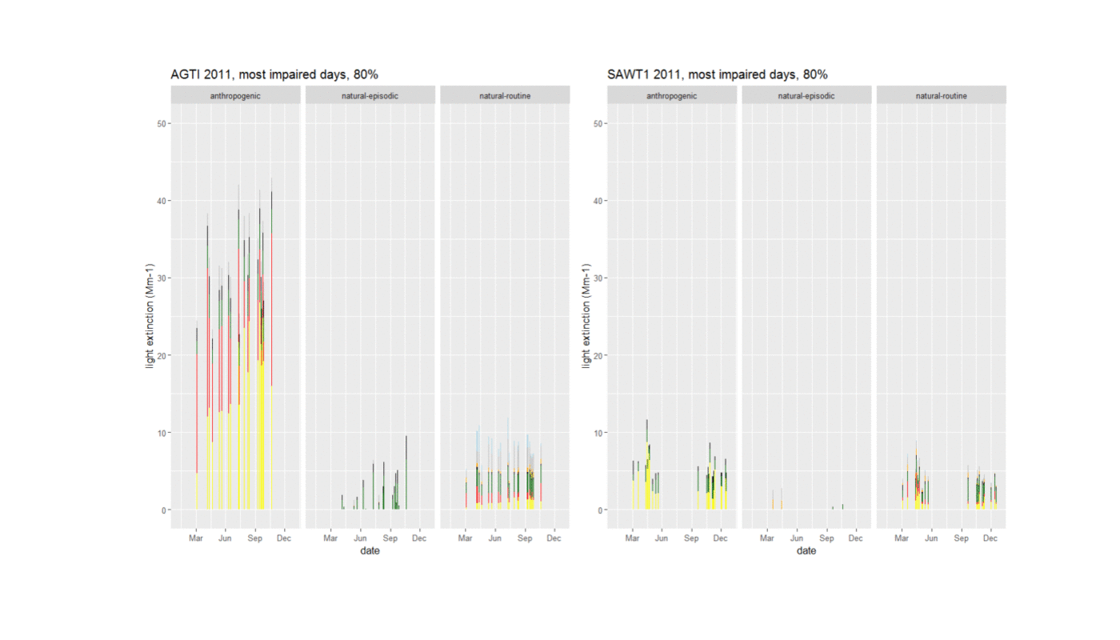
Sample year - 2011

Slide 57
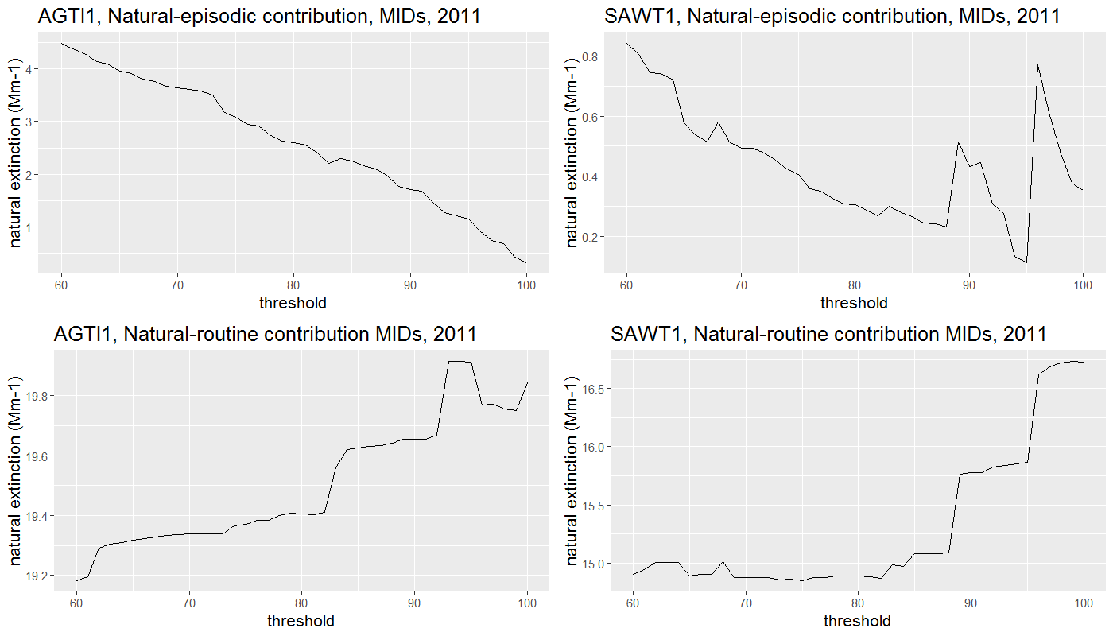

Slide 58
Sample year - 2011
SAWT1
Animation shows how the MID’s shift to the summer wildfire-likely impacts
This increases the natural-routine contribution as indicated on the previous slide

Slide 59
Case study conclusion
For SAWT1,
assigned anthropogenic levels more comparable to the natural-routine portions
MIDs are more sensitive to threshold adjustment
As threshold increases, more of the MIDs occur during wildfire-likely impacts
Those elevated carbon MIDs increase natural-routine portion, which causes the sudden change in behavior

Slide 60
Overview for next steps
Refine natural conditions estimates (perhaps site/region-specific and season-specific) to avoid possible artifacts in the data, hopefully current modeling simulations will be useful tools (see slide 30)
As levels approach natural conditions, this becomes more important
In future metric improvements, allow for episodic impacts to occur while not necessarily introducing anthropogenic
States:
Evaluate if the metric adequately accounts for episodic impacts at their sites
Look at yearly data, archived satellite data to confirm
Look at how natural-routine changes with threshold for indicators of MID sensitivity

Slide 61
Contact
Brandon McGuire, bmcguire@mt.gov, 406-444-6257
Tom Moore, tmoore@westar.org
Coordination and Glide Path Subcommittee, http://wrapair2.org/RHP_coordination.aspx

